Slide 1
online webinar
Top tips for submitting Silver & Gold CREST Awards
Sep 2023
Managed by
Supported by

Slide 2
Introductions
Thanks for joining us! ​
Maria Rossini, Head of Education
Cristine​ Alcantara, Operations & Data Manager
Please put questions in the chat

Slide 3
Objectives
Provide an overview of CREST Gold and Silver Awards
Describe the relevant Award levels and look at ways to organize and record your work
Explain how to navigate the project submission process ​
Provide top tips for success​
Answer your questions​!

Slide 4
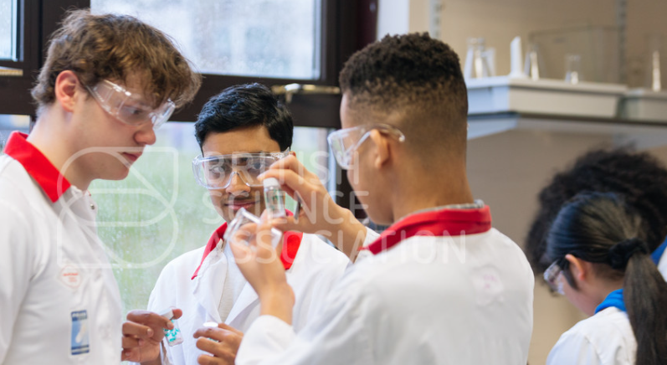
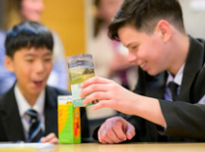
Poll
Not started my project yet
Done a project/placement already, but not written it up
Finished writing up my project but not submitted
Already submitted for CREST and have questions about the process

Slide 5
CREST Awards
an overview

Slide 6
The British Science Association

Slide 7
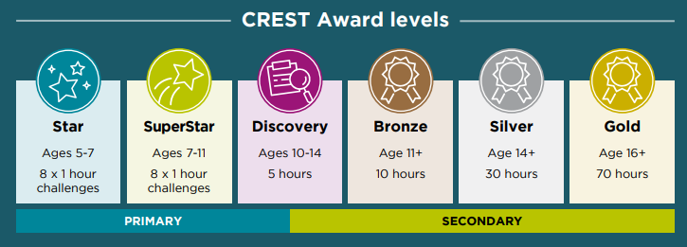
CREST Awards
The BSA’s flagship education programme
Been running for over 36 years
Aims to inspire young people to think like researchers and scientists
Externally assessed

Slide 8
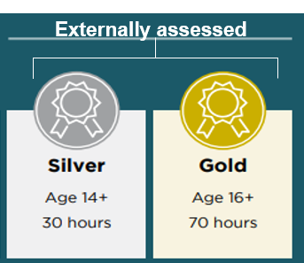
Gold and Silver CREST Awards
Any area of STEM
Traditional investigation (Hypothesis/methodology/conclusions)
Design and making (both real and digital)- (problem/aims/design solutions/testing/evaluation. Links well with GCSE and A level D&T coursework)
Literature review style research- (Well researched and referenced essay on a STEM topic. Often links well with EPQ)
Communication- (Developing a communication solution for an area of STEM with a particular audience. Still following a project process and including research on the topic and the needs of the audience)

Slide 9
Eligible subject areas
Astrology
Biology
Chemistry
Design technology
Drama
Economics
Electronics
Engineering
English
Environmental science
Food technology
Geography
History
ICT/ Computer Science
Maths
Music
Physics
Psychology
Sociology
Textiles
Other
Notes:
Practical Investigation are one of the most common project types for CREST. They aim to answer a question, hypothesis or problem.
These projects aim to design and create a product that meets a specific aim. Design and Make projects can start with a broad scope, which is then narrowed down to something more specific.
Example: Past topics have included designing and making a skateboard and designing and building a model catamaran.
These projects aim to provide a fresh perspective or strengthen an argument for a disputed STEM topic through data gathering and analysis.
Example: Past projects have included topics such as, 'The effects of reminding students about their previous grades on exam performance’
These projects aim to inform a specific audience about a topic or raise their awareness and interest in STEM.
Example: Past projects have included students developing a science show; building an interactive museum exhibit that explained a scientific principle; and a radio show where students interviewed a scientist.

Slide 10
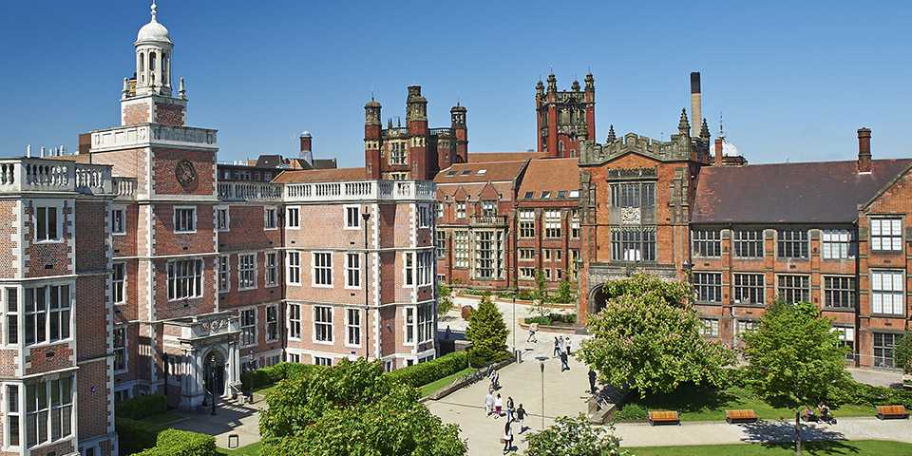
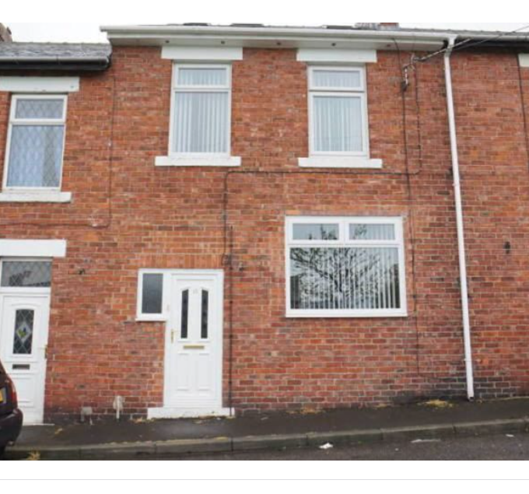
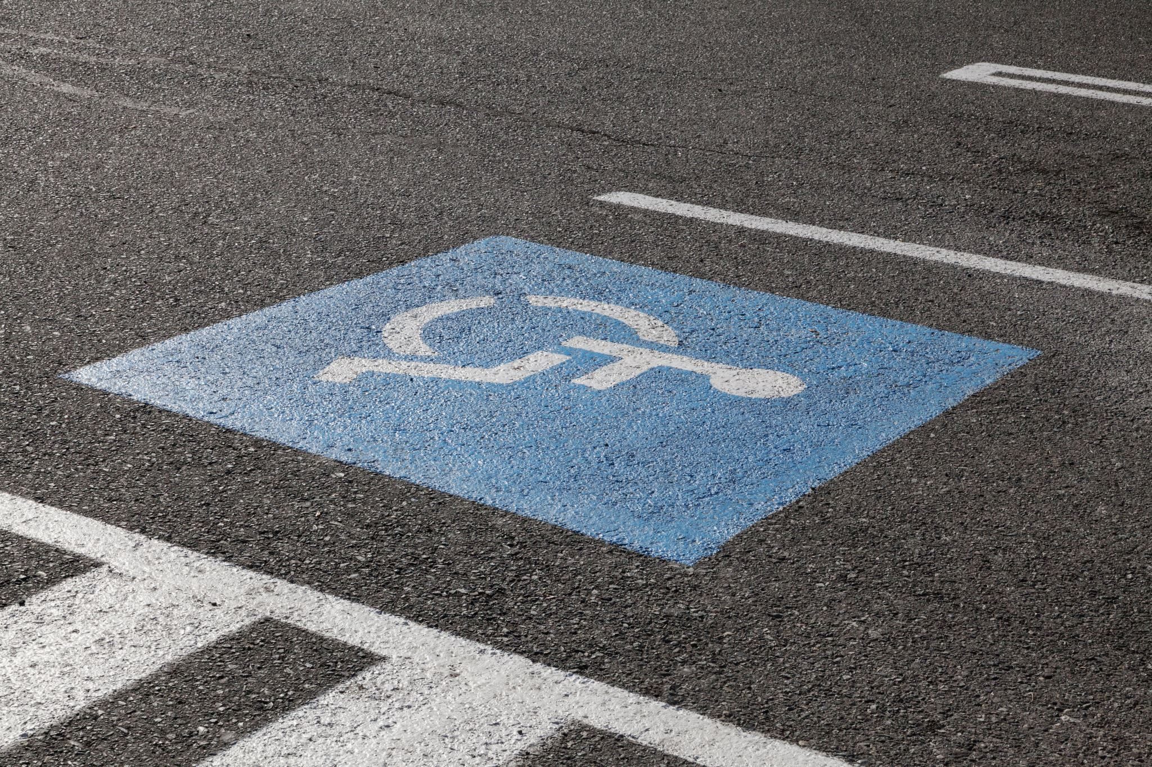
Case study
Student X:
FSM
Living in area of high deprivation, with a disabled parent
Dropped out of school
Continued a summer placement, where she did CREST Gold
Went back to school
Got top A level grades
Graduated with a 2.1 from Newcastle University
Receiving my CREST Award gave me the boost I needed to get back into science and gave me something interesting to talk about in my University applications. It was a pivotal point in my career, and I don’t think I’d have studied/worked in STEM without it.
This Photo by Unknown Author is licensed under CC BY-SA-NC

Slide 11
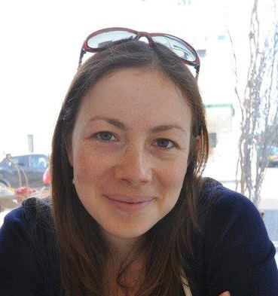
Student X
Now I work for the British Science Association and I love that my job has taken me full circle to encouraging other young people to get the most out of doing a CREST Award

Slide 12
Benefits of having a CREST Award
Well respected by universities and employers​
Provides evidence and recognition of your project work skills​
Emphasises the real-world context of your research​
Enhances your CV and UCAS personal statement ​
Illustrates your employability skills​
Can help to develop your professional network​
Illustrates additional effort, commitment​ and interest
Provides interviewers with something interesting to ask you about​

Slide 13
Employability skills
Collaboration/teamwork
Organisation
Time management
Lone working, using your initiative
Problem solving
Creativity
Decision making
Research
Technology use
Data processing
Analysis
Leadership
Reflection

Slide 14
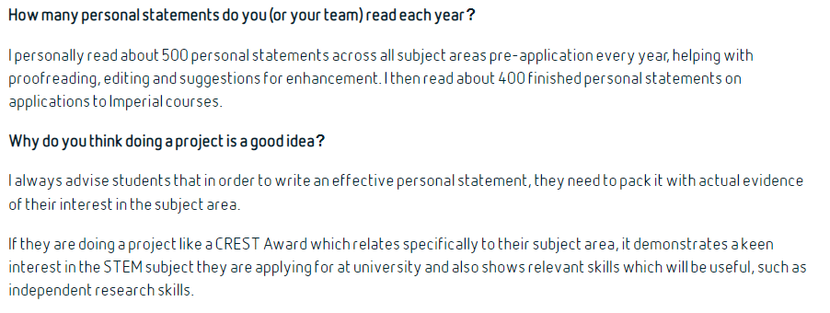
Personal statements

Slide 15
Personal statements
https://www.britishscienceassociation.org/Blog/expert-tips-that-will-make-any-ucas-personal-statement-stand-out

Slide 16
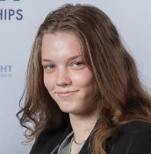
Student feedback

Slide 17
Student feedback
https://www.britishscienceassociation.org/Blog/education-underrepresentation-and-the-next-generation-a-crest-awards-case-study

Slide 18
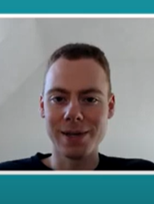
Student feedback
https://www.britishscienceassociation.org/Blog/how-crest-awards-boost-ucas-applications-university-admission-interviews

Slide 19
Types of project work
Practical investigation
Design and make
Research
Communication
Presenting project work
Written report
Scientific poster
PowerPoint
Video
Series of blog posts
Notes:
Practical Investigation are one of the most common project types for CREST. They aim to answer a question, hypothesis or problem.
These projects aim to design and create a product that meets a specific aim. Design and Make projects can start with a broad scope, which is then narrowed down to something more specific.
Example: Past topics have included designing and making a skateboard and designing and building a model catamaran.
These projects aim to provide a fresh perspective or strengthen an argument for a disputed STEM topic through data gathering and analysis.
Example: Past projects have included topics such as, 'The effects of reminding students about their previous grades on exam performance’
These projects aim to inform a specific audience about a topic or raise their awareness and interest in STEM.
Example: Past projects have included students developing a science show; building an interactive museum exhibit that explained a scientific principle; and a radio show where students interviewed a scientist.

Slide 20
Your report/portfolio/evidence
How you structure/present it is up to you. Chat to your mentor/teacher about a suitable format
Many people follow a ‘scientific paper’ format. (Intro/aims/research methods/results/conclusion)
Can be creative
Show how you meet the CREST criteria along the way (you could use some CREST criteria as titles/headers to help you structure the write up if you want)
If you work in a team- you can all work on the report together, but your reflection section and profile form should be different
www.crestawards.org

Slide 21
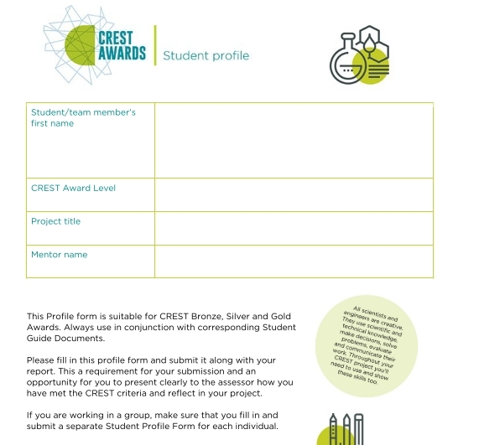
Student profile form
https://secondarylibrary.crestawards.org/crest-student-profile-form/62632654

Slide 22
1. Planning your project
1 – Planning your project
1.1 You have set a clear aim for the project and have broken it down into smaller objectives | Make sure you state your aims
1.2 You have explained a wider purpose for the project | Put the project in context
1.3 You have identified a range of approaches to the project | Show you thought of alternative approaches
1.4 You have described your plan for the project and why you chose that approach | Clearly lay out a plan and justify your choices
1.5 You have planned and organised your time well | Include timelines/diaries etc
www.crestawards.org

Slide 23
2. Throughout your project
2 – Throughout your project
2.1 You have made good use of the materials and people available | Explain who/how you worked with. Did you involve mentors? How did you gather resources?
2.2 You have researched the background to the project and acknowledged your sources appropriately | Do a background search and use referencing Reference tools you used too (eg any search engines/AI)
www.crestawards.org

Slide 24
3. Finalising your project
3 – Finalising your project
3.1 You have made logical conclusions and explained the implications for the wider world | Be reflective, and sum up your project and it’s implications
3.2 You have explained how your actions and decisions affected the project’s outcome | Look back on the decisions you made, and reflect on their impact.
3.3 You have explained what you have learnt and reflected on what you could improve | Would you change anything if you did this again?
www.crestawards.org

Slide 25
4. Project-wide criteria
4- Project-wide criteria
4.1 You have shown understanding of the science behind your project, appropriate to the Award level
4.2 You have made decisions to direct the project, taking account of ethical and safety issues
4.3 You have shown creative thinking
4.4 You have identified and overcome problems successfully | *be honest about issues and how you deal with them
4.5 You have explained your project clearly, in writing or conversation
www.crestawards.org

Slide 26
Criteria and assessment- Top tips!
Familiarise yourself with the CREST criteria and structure your project with these in mind
If you create PowerPoints and videos, make sure you give enough detail to evidence that you meet the criteria
For the project report, number the pages (this will help you easily find information to complete the Silver/Gold profile form)
List the sources of your research information. Please use your preferred reference format
Avoid plagiarism or you will be penalised
Communicate your enthusiasm, explain why you are interested in your topic
Don’t forget to upload a profile form!

Slide 27
Application process
Sign up to CREST Apply
Team members submit for themselves - (can upload the same project report but with different profile forms)
Tell us about your project
Tell us about yourself, or your team/group
Diversity information
Upload student profile form (easier to complete before)
Upload project work
Confirmations about plagiarism
Input voucher code if you have one (payment section)
On average assessment process 6 weeks for Silver & Gold

Slide 28
Application process:
https://apply.crestawards.org
APPLICATION
PAYMENT
ASSESSMENT
(Silver and Gold)
DECISION NEEDED
(Silver and Gold)
AWARD
Claim your CREST Award using a voucher or request for your invoice which you may pay online or through BACS
Silver/Gold assessment takes between two and six weeks, depending on time of year
Sometimes, Silver and Gold projects will be recommended for resubmission or offered a lower level
Sometimes, Silver projects will be offered an upgrade
Must meet at least 11 of 15 CREST criteria to achieve the Award
Decide whether to resubmit or accept the offered Award level
When resubmitting, the project will be moved to the application, round so you will be able to upload additional or replacement files for your project
When accepting an upgrade, you will be moved to the payment round to pay for the upgrade fee
Certificates are printed after assessor confirmed you achieved the Award (for Silver and Gold)
Certificate printing and delivery takes between three to six weeks to UK addresses. International postage may be longer.
Tell us about yourself or your group
Provide your diversity information
Tell us about your project
Upload your work
Confirmation of your work
Important to upload a completed CREST student profile form/s.

Slide 29
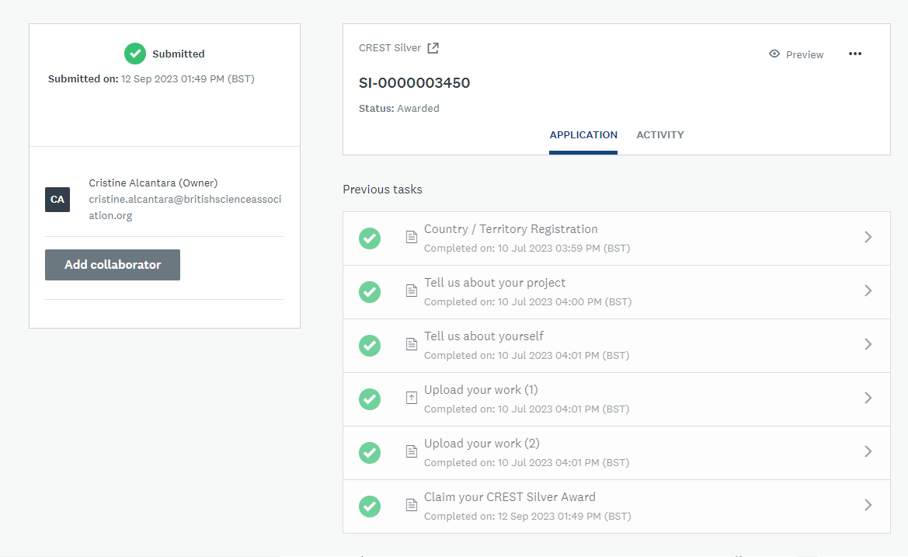
Application process:
https://apply.crestawards.org

Slide 30
Final top tips (From a personal point of view)
Make the most out of mentors and each other
Ask for help, and repeatedly if you need to​
Reference help/tools (eg AI)/research- well referenced projects move you from ‘plagiarism’- to ‘making good use of materials and resources’
Remember to communicate your enthusiasm
Invest time in the process/in yourself
It’s worth it!

Slide 31
Further information
CREST Award Criteria (Bronze, Silver & Gold)
https://help.crestawards.org/portal/en/kb/articles/criteria-for-bronze-silver-and-gold-crest-awards
Silver Award - student guide​
https://secondarylibrary.crestawards.org/student-guide-silver/62444085​
​
Gold Award - student guide​
https://secondarylibrary.crestawards.org/student-guide-gold/62444084​
​
Student profile form​
https://secondarylibrary.crestawards.org/crest-student-profile-form/62632654​
​
CREST Help Centre​
https://help.crestawards.org/
​
Email
crest@britishscienceassociation.org​

Slide 32
Any questions?
Thank you and good luck
with your submissions!​

