Slide 1
Supported by:
Early years and primary challenges
Suitable for ages 3-7, or those working at this level

Slide 2
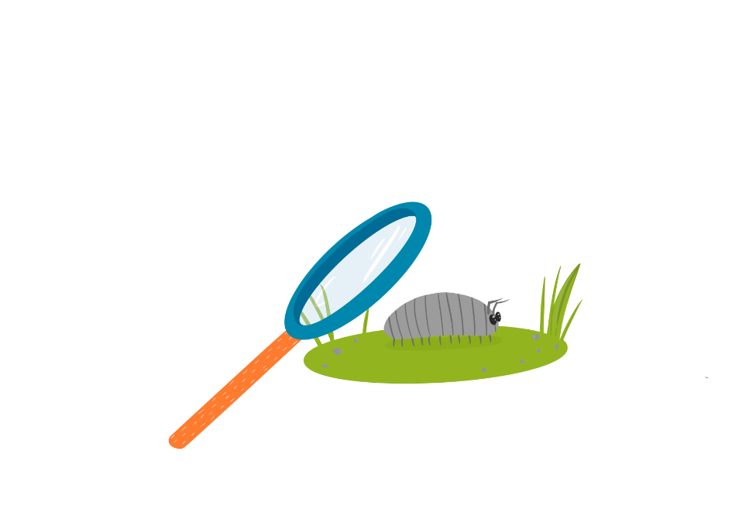
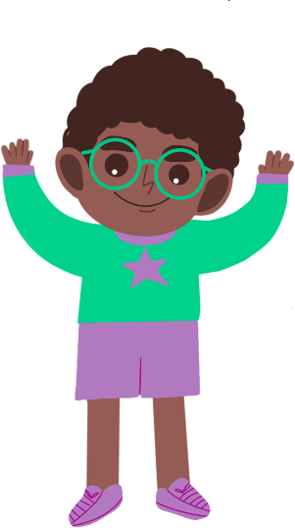
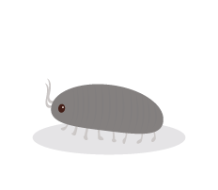
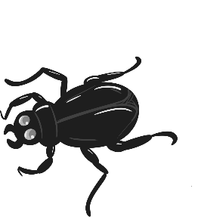
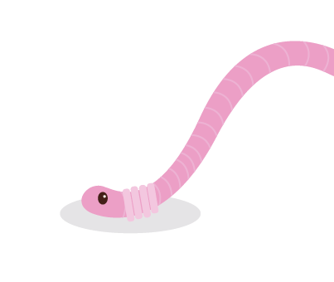
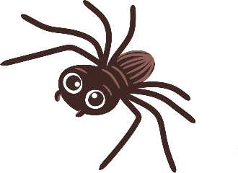
Animal Adventure

Slide 3
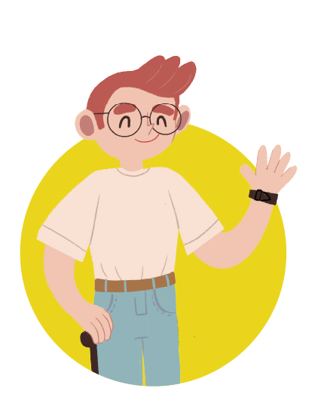
Meet the characters...
Cosmic
Seren
Uncle Astro
Uncle to Cosmic and Gem

Slide 4
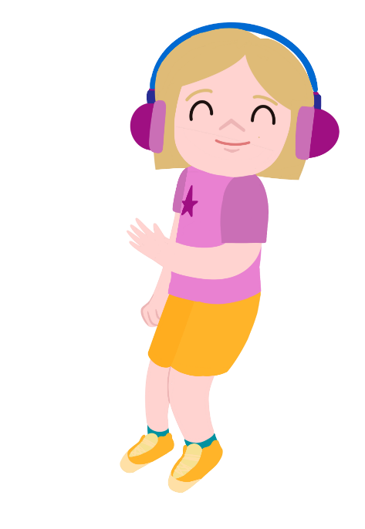
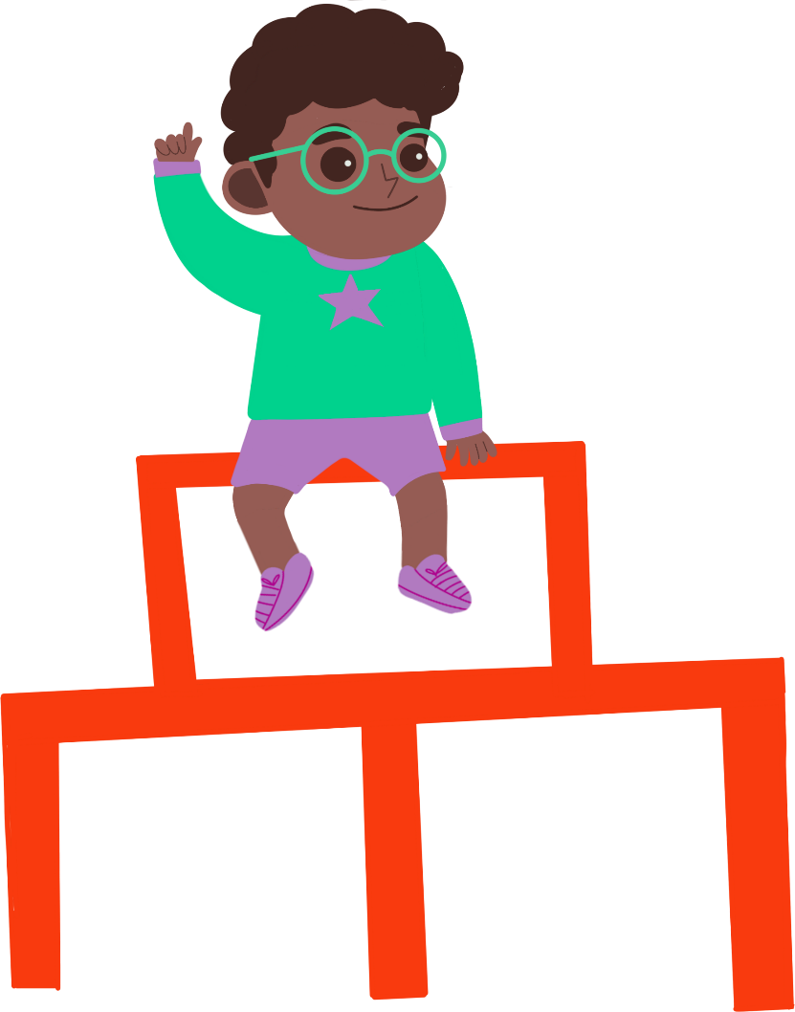
Cosmic and Seren are in Cosmic’s garden.
Let’s go on an animal safari!
Do you mean with toy animals?
They are trying to think of something to do.

Slide 5
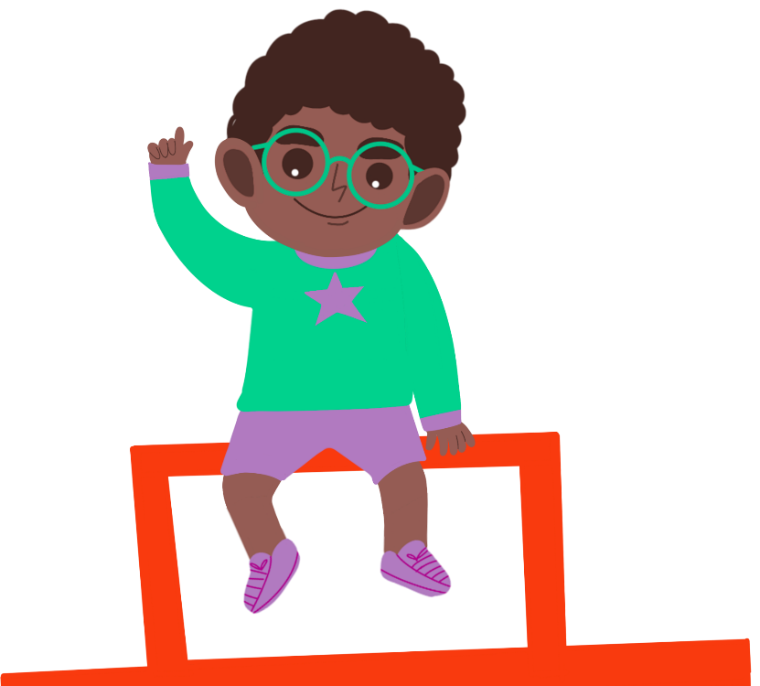
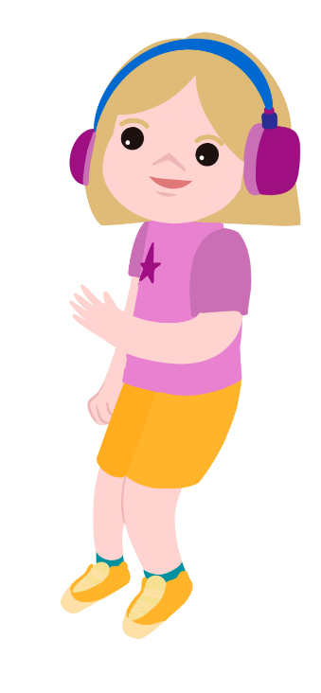
No, I mean a real animal adventure!
I can’t see any animals in the garden.

Slide 6
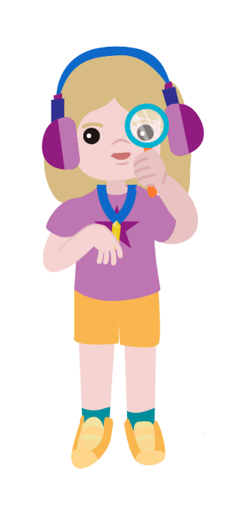
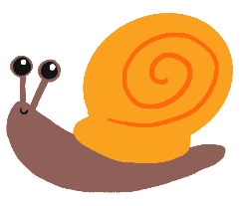
Uncle Astro says that there are little animals called minibeasts all around us.
We just can’t see them.
Let’s see if Uncle Astro can help us find them.

Slide 7
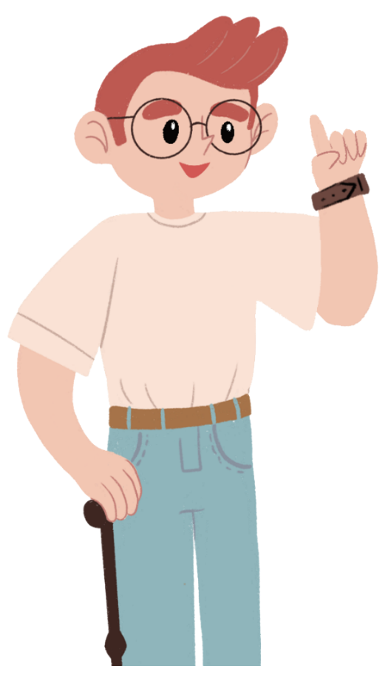
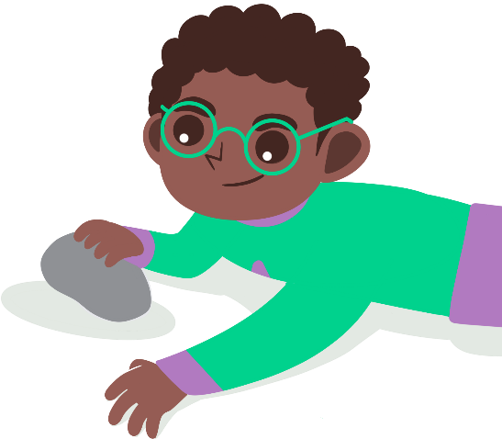
Where will Uncle Astro tell Cosmic and Seren to look?
I think we will find the minibeasts under logs and stones.
I think we will need to look in trees and on the top of walls.
What do you think?

Slide 8
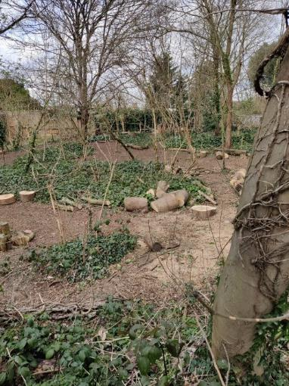
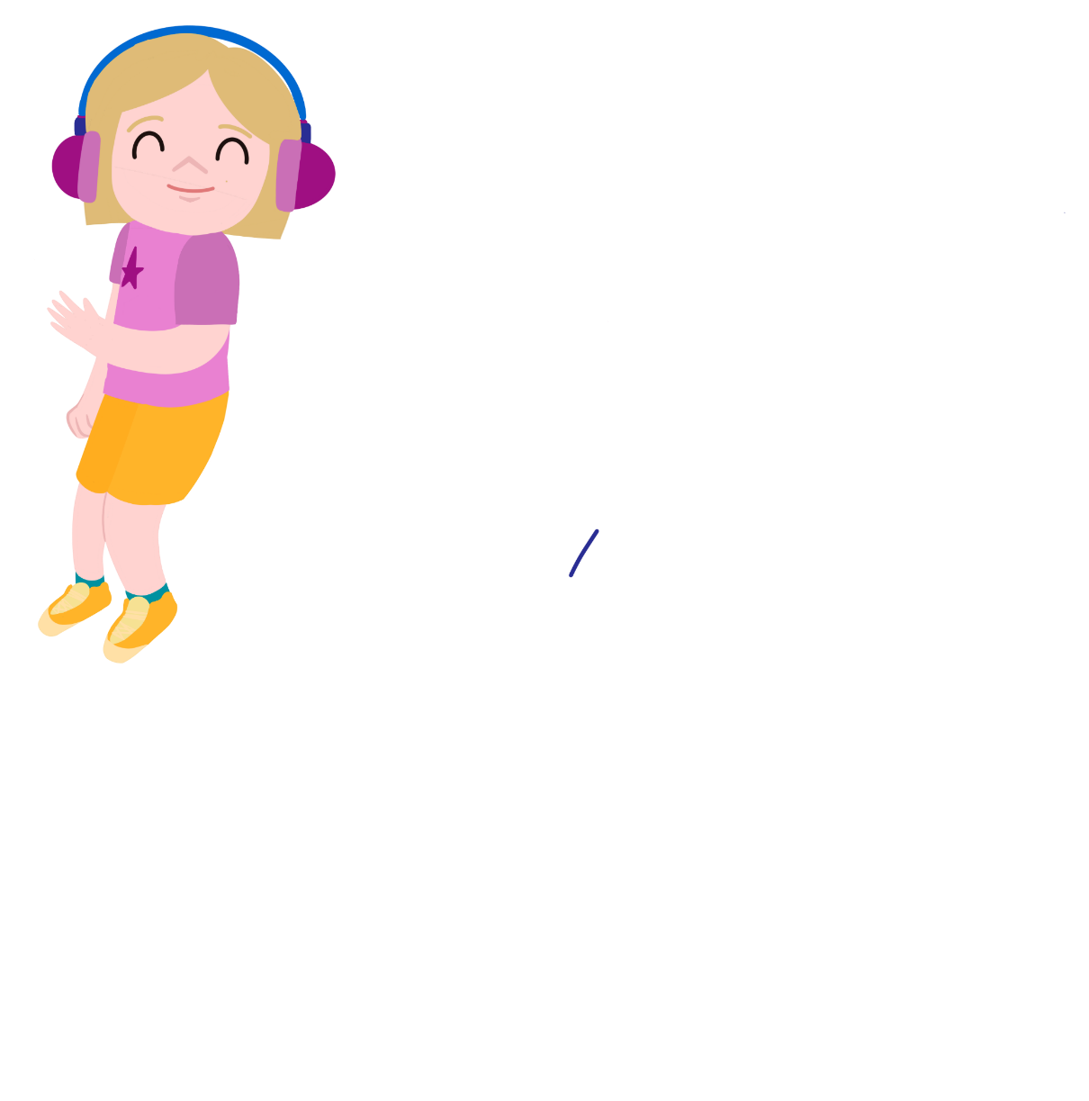
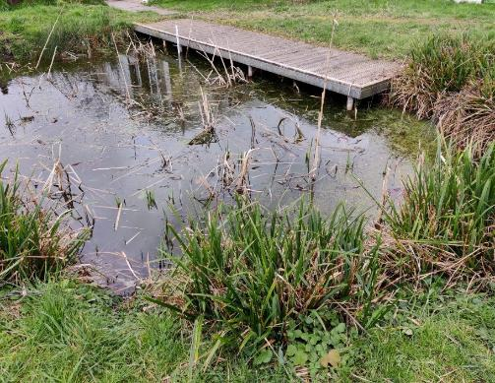
We are going on a minibeast hunt!
Where will we look for minibeasts?
How will we stay safe?

Slide 9
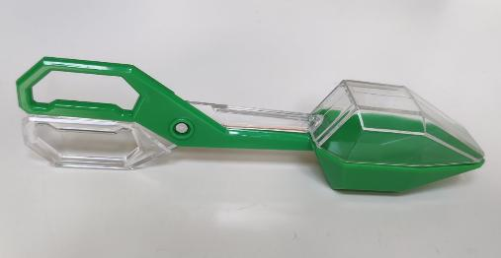
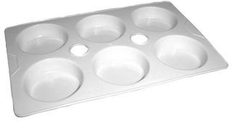
Collecting minibeasts
How will we make sure we don't harm them?

Slide 10
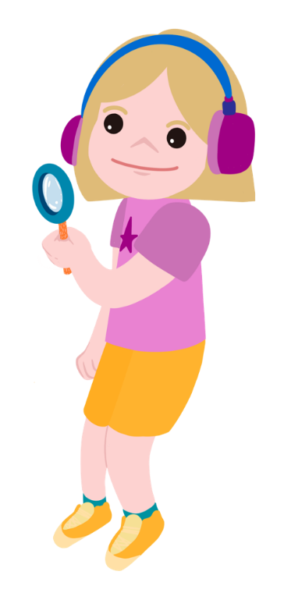
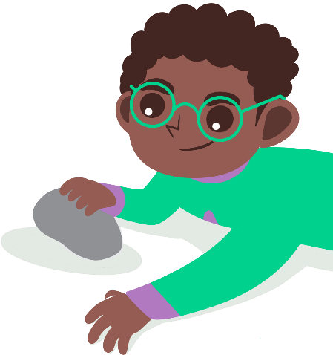
Looking at the minibeasts
You could draw the minibeasts that you find or take photos of them!
This magnifying glass makes things look bigger!
Do you know what any of the minibeasts are called?

Slide 11
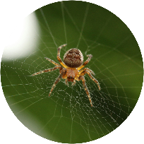
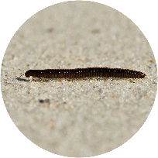
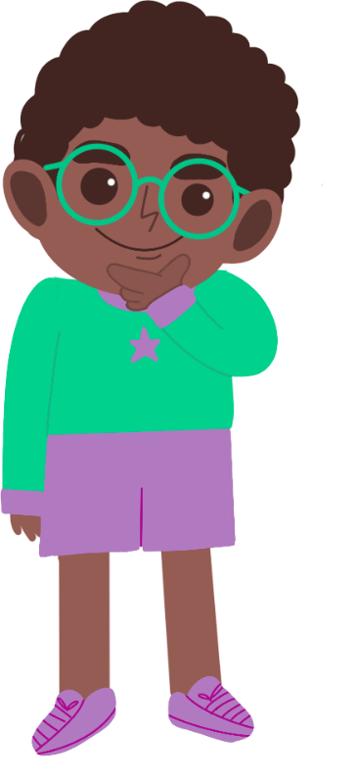
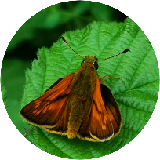
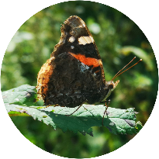
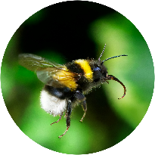
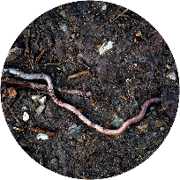
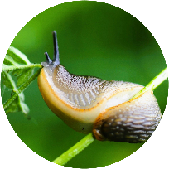
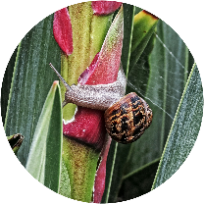
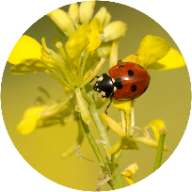
What did you find?
Where did you find the most minibeasts?
Where do you think they like to live?
Why?

Slide 12
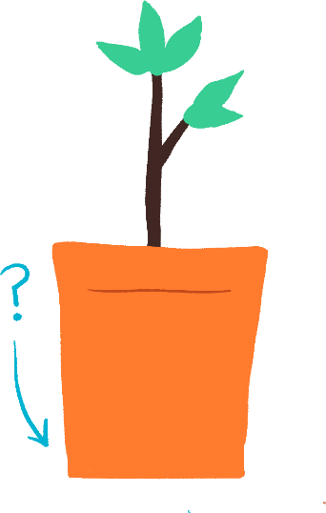
Take it further...
Maybe you could design a home or bug hotel for the minibeasts!
Can you think of other places to look for minibeasts?​
Can you make up a song or poem about a minibeast?

Slide 13
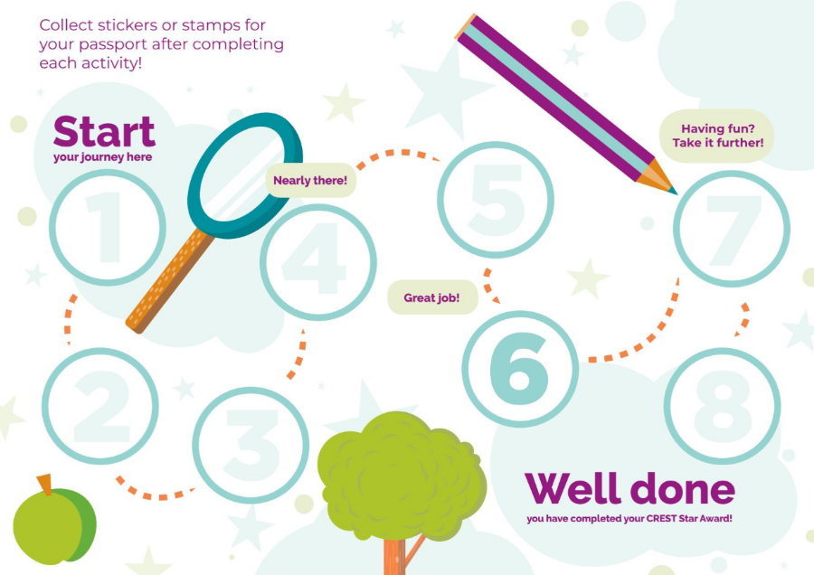
Well done!
You can add a stamp or sticker to your CREST Passport!

Slide 14
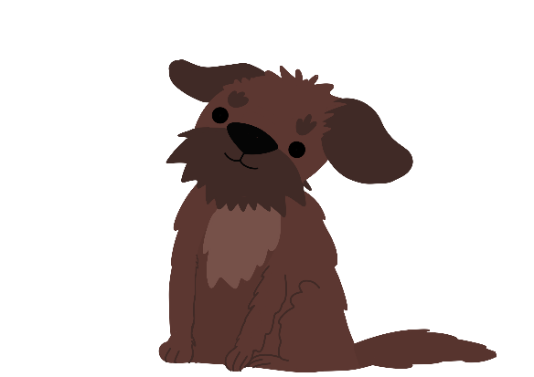
Be Seen, Be Safe

Slide 15
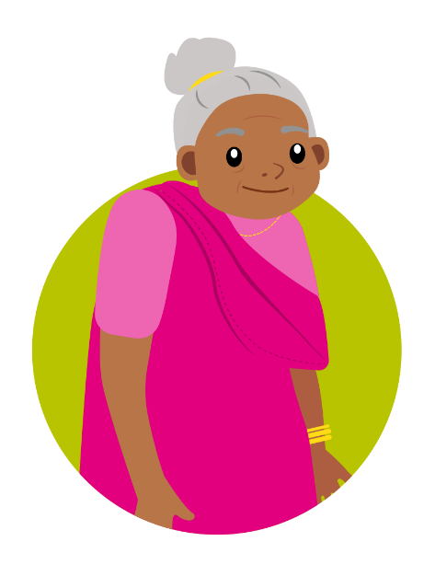
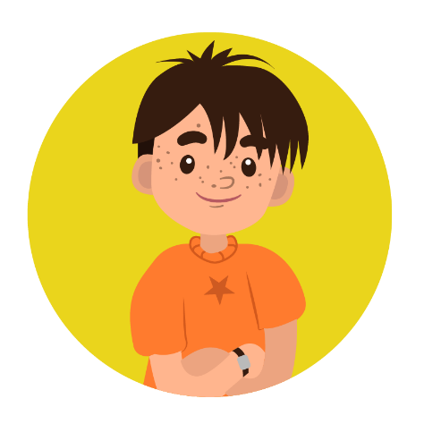
Meet the characters...
Tara
Luna
Zeke's new dog
Zeke
Joyti
Grandmother to Tara

Slide 16
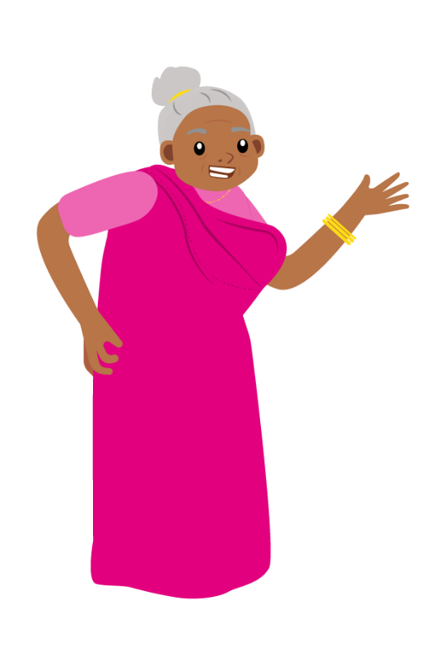
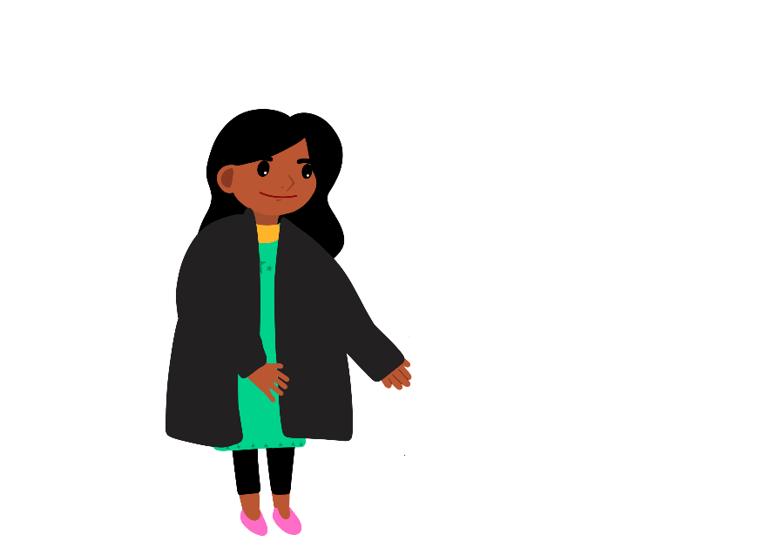
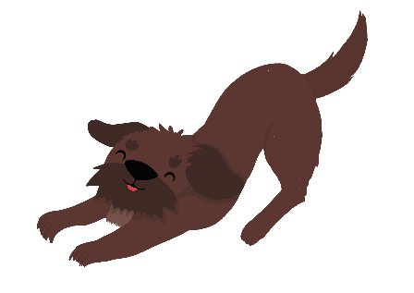
Tara can't wait to take Luna for a walk!
I’m so excited about taking Zeke’s new dog, Luna, for a walk this afternoon!
Hold on! It is going to get dark soon. It’s not safe to go out in your black coat.

Slide 17
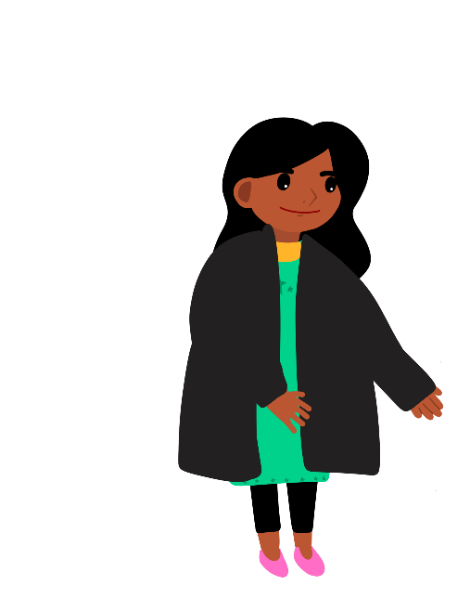
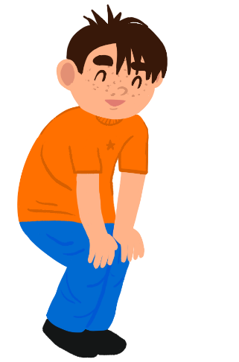
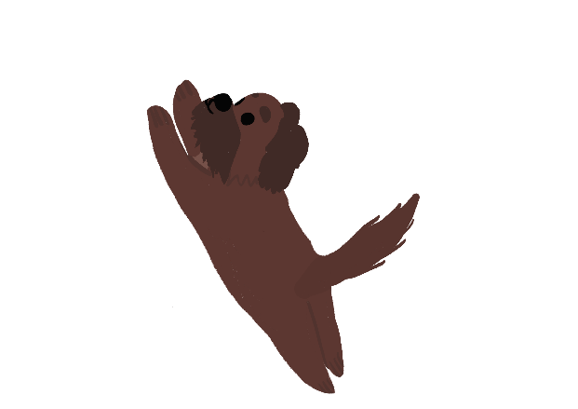
Tara's grandma thinks she needs to wear something different.
What do you mean?
Once it is dark outside, you won’t be seen in a black coat.
Let’s find you something that will keep you seen and safe!

Slide 18
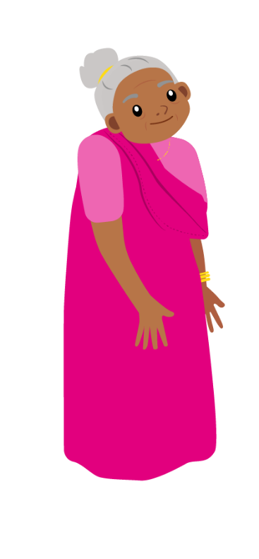
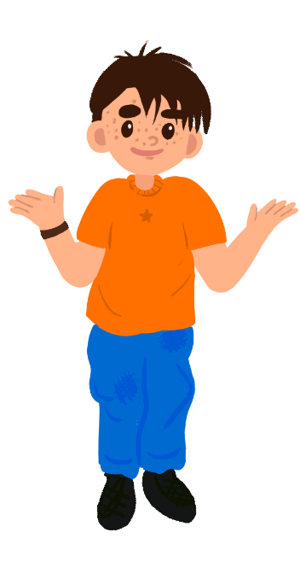
What do you think?
I think you should wear something white.
I don’t think it makes any difference what you wear.
I think I need to wear something shiny to be seen.

Slide 19
Which materials do you think can be seen in the dark?
How will you test them?

Slide 20
Testing the materials
Dark space
Torch

Slide 21
Recording your results
What should Tara and Zeke wear to be safe outside at night?
Put the materials in order from the most difficult to the easiest to see in the dark. You could take a photo!
Can you design something for them to wear?

Slide 22
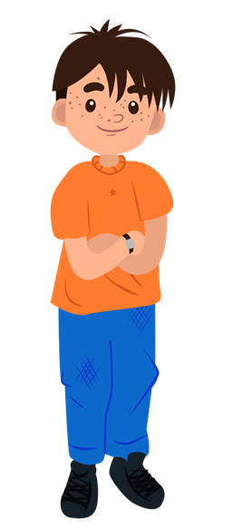
Take it further...
Can you make a poster to help other children stay safe outside at night?
Maybe I should design a special coat for Luna! Can you help me?

Slide 23
Well done!
You can add a stamp or sticker to your CREST Passport!

Slide 24
Peggy Problem

Slide 25
Meet the characters...
Aunt Stella
Auntie to Cosmic and Gem
Gem
Cosmic

Slide 26
Aunt Stella is doing some washing.
Warm and windy! It’s a perfect day for washing clothes.
Can we help hang the washing out to dry?

Slide 27
Some of the clothes fall off the washing line.
Oh no! I don't think the clothes pegs are grippy enough!
We could test some different pegs to see if they would be better!

Slide 28
Which pegs do you think have the best grip?
I think a peg with a spring will have the most grip
I think plastic pegs will have a tight grip.
I think wooden pegs will have the best grip as wood is stronger.

Slide 29
Which peg do you think will work best?
How can you find out?

Slide 30
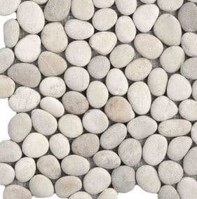
Testing
pegs
socks
pebbles, marbles or sand
washing line

Slide 31
Recording your results
You could take photos or draw pictures of your results!
Which peg should I use?

Slide 32
Take it further...
I wonder if some clothes dry faster than others?
Do clothes dry better on a windy day or a still day? How could we find out?

Slide 33
Well done!
You can add a stamp or sticker to your CREST Passport!

Slide 34
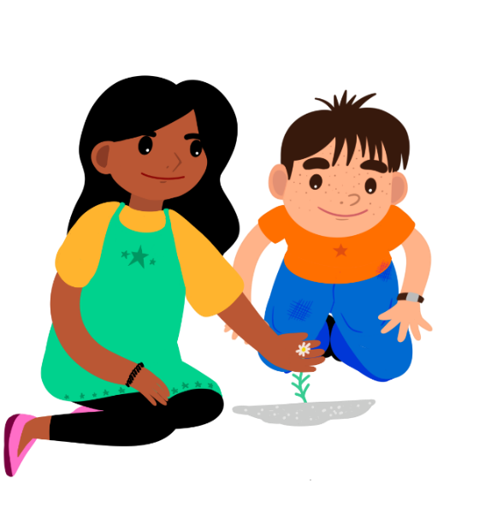
Plant Detectives

Slide 35
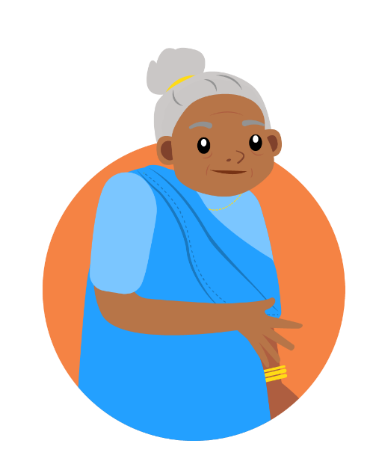
Meet the characters...
Tara
Zeke
Joyti
Grandmother to Tara

Slide 36
Zeke has spotted something outside Tara's house.
How did that plant get there? Plants usually grow in gardens, not pavements!

Slide 37
What a mystery!
I wonder whether it might have grown from a seed under the pavement. Who could have planted the seed?
Maybe someone dropped it as they walked along!

Slide 38
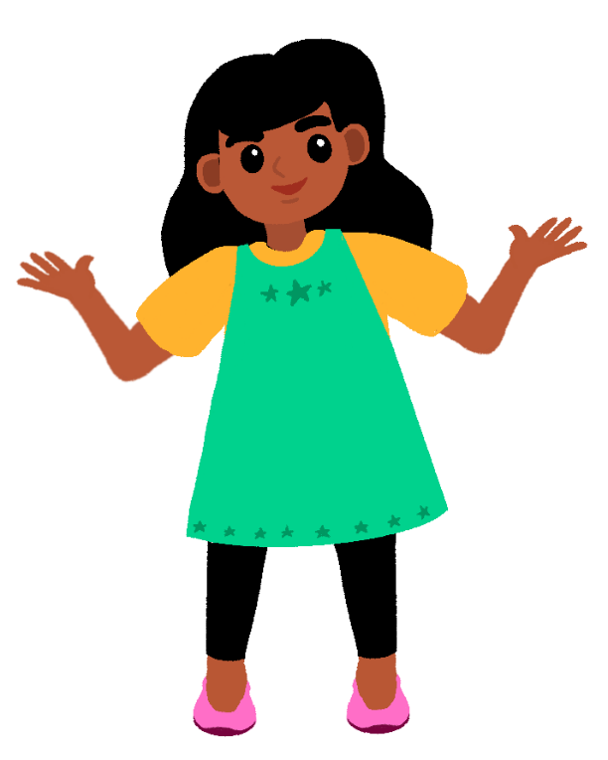
How can Tara and Zeke find out more?
We need to be plant detectives and solve this mystery!
Where have you seen plants growing?

Slide 39
Where will we go to be plant detectives?
Where will we look for clues about plants?
How will we stay safe?

Slide 40
Recording your results
You could draw pictures or take photos of the plants you find.
Maybe you could mark them on a map!

Slide 41
Take it further...
Can you find out the names of the plants you discover?
Do all plants need soil to grow?

Slide 42
Well done!
You can add a stamp or sticker to your CREST Passport!

Slide 43
Sneaky Shadow

Slide 44
Meet the characters...
Seren
Aunt Stella
Auntie to Cosmic and Gem
Gem

Slide 45
Seren is worried.
I've lost my shadow. It was there when I was outside playing. It was there when I walked home from school. Now it's gone.
Seren goes to Gem's house.
Maybe they can find her shadow in the garden.

Slide 46
It is getting dark outside.
I can help you find your sneaky shadow with this torch!
It was under the outside light, but it disappeared when it went off!

Slide 47
What makes a shadow?
I think you will see your shadow if there is bright light.
I think you can only see your shadow when the sun is shining.
I think shadows hide when it goes dark.

Slide 48
How can you find out?
torch

Slide 49
Make a shadow puppet

Slide 50
Recording your results
Can you explain how to make a shadow?
Use your puppet to make and share a shadow play!
You could try setting up a little shadow puppet theatre!

Slide 51
Who do you agree with?
I think you will see your shadow if there is bright light.
I think shadows hide when it goes dark.
I think you can only see your shadow when the sun is shining.

Slide 52
Take it further...
Can you make the size of a shadow change?
Is it possible to make a coloured shadow?

Slide 53
Well done!
You can add a stamp or sticker to your CREST Passport!

Slide 54
Sniffly Sneezes

Slide 55
Meet the characters...
Tara
Zeke
Joyti
Grandmother to Tara

Slide 56
Poor Zeke has a cold.
I’ve brought you a lolly to cheer you up. Your nose is all red, it must be sore.
Achoo! Achoo! Achoo! Oh dear! What a horrible sniffly sneeze!

Slide 57
Poor Zeke has a cold.
It’s my hankie. It doesn’t work very well. I wish I had a better one.
I’m sure we can find something. I’ll ask my grandma, Joyti, to help us. She will have lots of things we could try. How will we know which is best?

Slide 58
What makes a good hankie?
I think a hankie needs to be soft on your nose.
I think it needs to be strong when it is wet.
I think it needs to soak up water to keep your nose dry.

Slide 59
Which material will make the best hankie?
How will you find out?

Slide 60
Testing the materials
tray
pipette
liquid

Slide 61
Recording your results
Sort the materials into the ones that worked well and the ones that didn't.
Did you get the same results as other children?
Which material would make the best hankie for me?

Slide 62
Take it further...
Why do we sometimes choose tissues that we can throw away?
A hankie needs to be able to soak up liquid. Are there any other tests we should carry out?

Slide 63
Well done!
You can add a stamp or sticker to your CREST Passport!

Slide 64
Testing Timers

Slide 65
Meet the characters...
Uncle Astro
Uncle to Cosmic and Gem
Gem
Cosmic
Seren

Slide 66
Cosmic, Gem and Seren are practising for Sports Day.
But we won’t be able to see a clock outside to time how many beanbags we can get in the hoop in a minute!
Off you go into the garden to practice, before something gets broken!

Slide 67
Why don’t you make your own sand timer to take outside?
What’s a sand timer and how does it work?

Slide 68
Have you ever seen a sand timer?
How do you think they work?

Slide 69
How can we make one?
I think it will depend on the size of the hole in the timer.
I think we'll only need a little bit of sand.
I think we'll need a lot of sand to measure one minute!

Slide 70
You are going to make your own sand timer!
cup
sand
pencil
tray

Slide 71
How long does your sand timer take?
Can you make your sand timer run for exactly one minute?
timer
clock

Slide 72
Recording your results
You could draw pictures, take photos or create a video showing how to make a sand timer.
Try using your sand timer to play the beanbag and hoop game with a friend!

Slide 73
Take it further...
Try putting more holes in your sand timer and see what happens!
What else could you use to make a timer?

Slide 74
Well done!
You can add a stamp or sticker to your CREST Passport!

Slide 75
Useless Umbrella

Slide 76
Meet the characters...
Aunt Stella
Auntie to Cosmic and Gem
Cosmic
Seren

Slide 77
Aunt Stella is off to a wedding.
You look great, but you should take an umbrella in case it rains!
What do you think of my special outfit?

Slide 78
There is a problem.
I don't have another one. What am I going to do?
Oh no! The umbrella is full of holes. It's useless!

Slide 79
Cosmic and Seren think they can fix the umbrella.
I think we need a brightly coloured, thin fabric to make it waterproof.
I think we need to use a sponge to make it waterproof.
I think we need a thick fabric to make it waterproof.
What do you think?

Slide 80
Which materials could fix the umbrella?
How will you find out?

Slide 81
Testing the materials
paper towel
liquid
tray
pipette

Slide 82
Recording your results
Would all the waterproof materials be good for fixing my umbrella?
Why?
You could sort the materials using a hoop.

Slide 83
Take it further...
Can you think of some other things you might want to keep out of the rain?
Can you think of a way of keeping them dry?

Slide 84
Well done!
You can add a stamp or sticker to your CREST Passport!

