Slide 1
DESIGN AND MAKE A PIZZA BOX
Bronze CREST Award
Managed by
Supported by

Slide 2
Parts of a pizza
What are the main parts of a pizza?
Dough base
Tomato sauce
Cheese
Notes:
What are the main three parts of a pizza? Students no doubt will know of a range of different pizzas, you can tell them that this pizza with no toppings is called a Margherita. It’s the most popular selling pizza in the UK!

Slide 3
Pizza toppings
Pizzas can have different toppings, such as:
mushrooms
tomatoes
Have you tried any different types of pizzas?
Notes:
Encourage students to name or list different pizza toppings. They can also use the ingredients vocab sheet to identify toppings that they like or have tried on pizzas.

Slide 4
We love pizza
Pizza was first invented in Italy.
Today, we love eating pizza in the United Kingdom.
We spend millions of pounds buying pizzas from shops and take aways.
Notes:
£638.95 million British pounds was spent on chilled pizza in the United Kingdom. Published by Statista Research Department, Jan 2, 2023.

Slide 5
Pizzas made in a factory
Notes:
Show the video clip (0-2.30 minutes) and use the prompt questions suggested in the Teacher’s guide.

Slide 6
A problem
Pizzas sometimes get squashed when the boxes get damaged in shops.
This causes waste as people do not want to buy them.

Slide 7
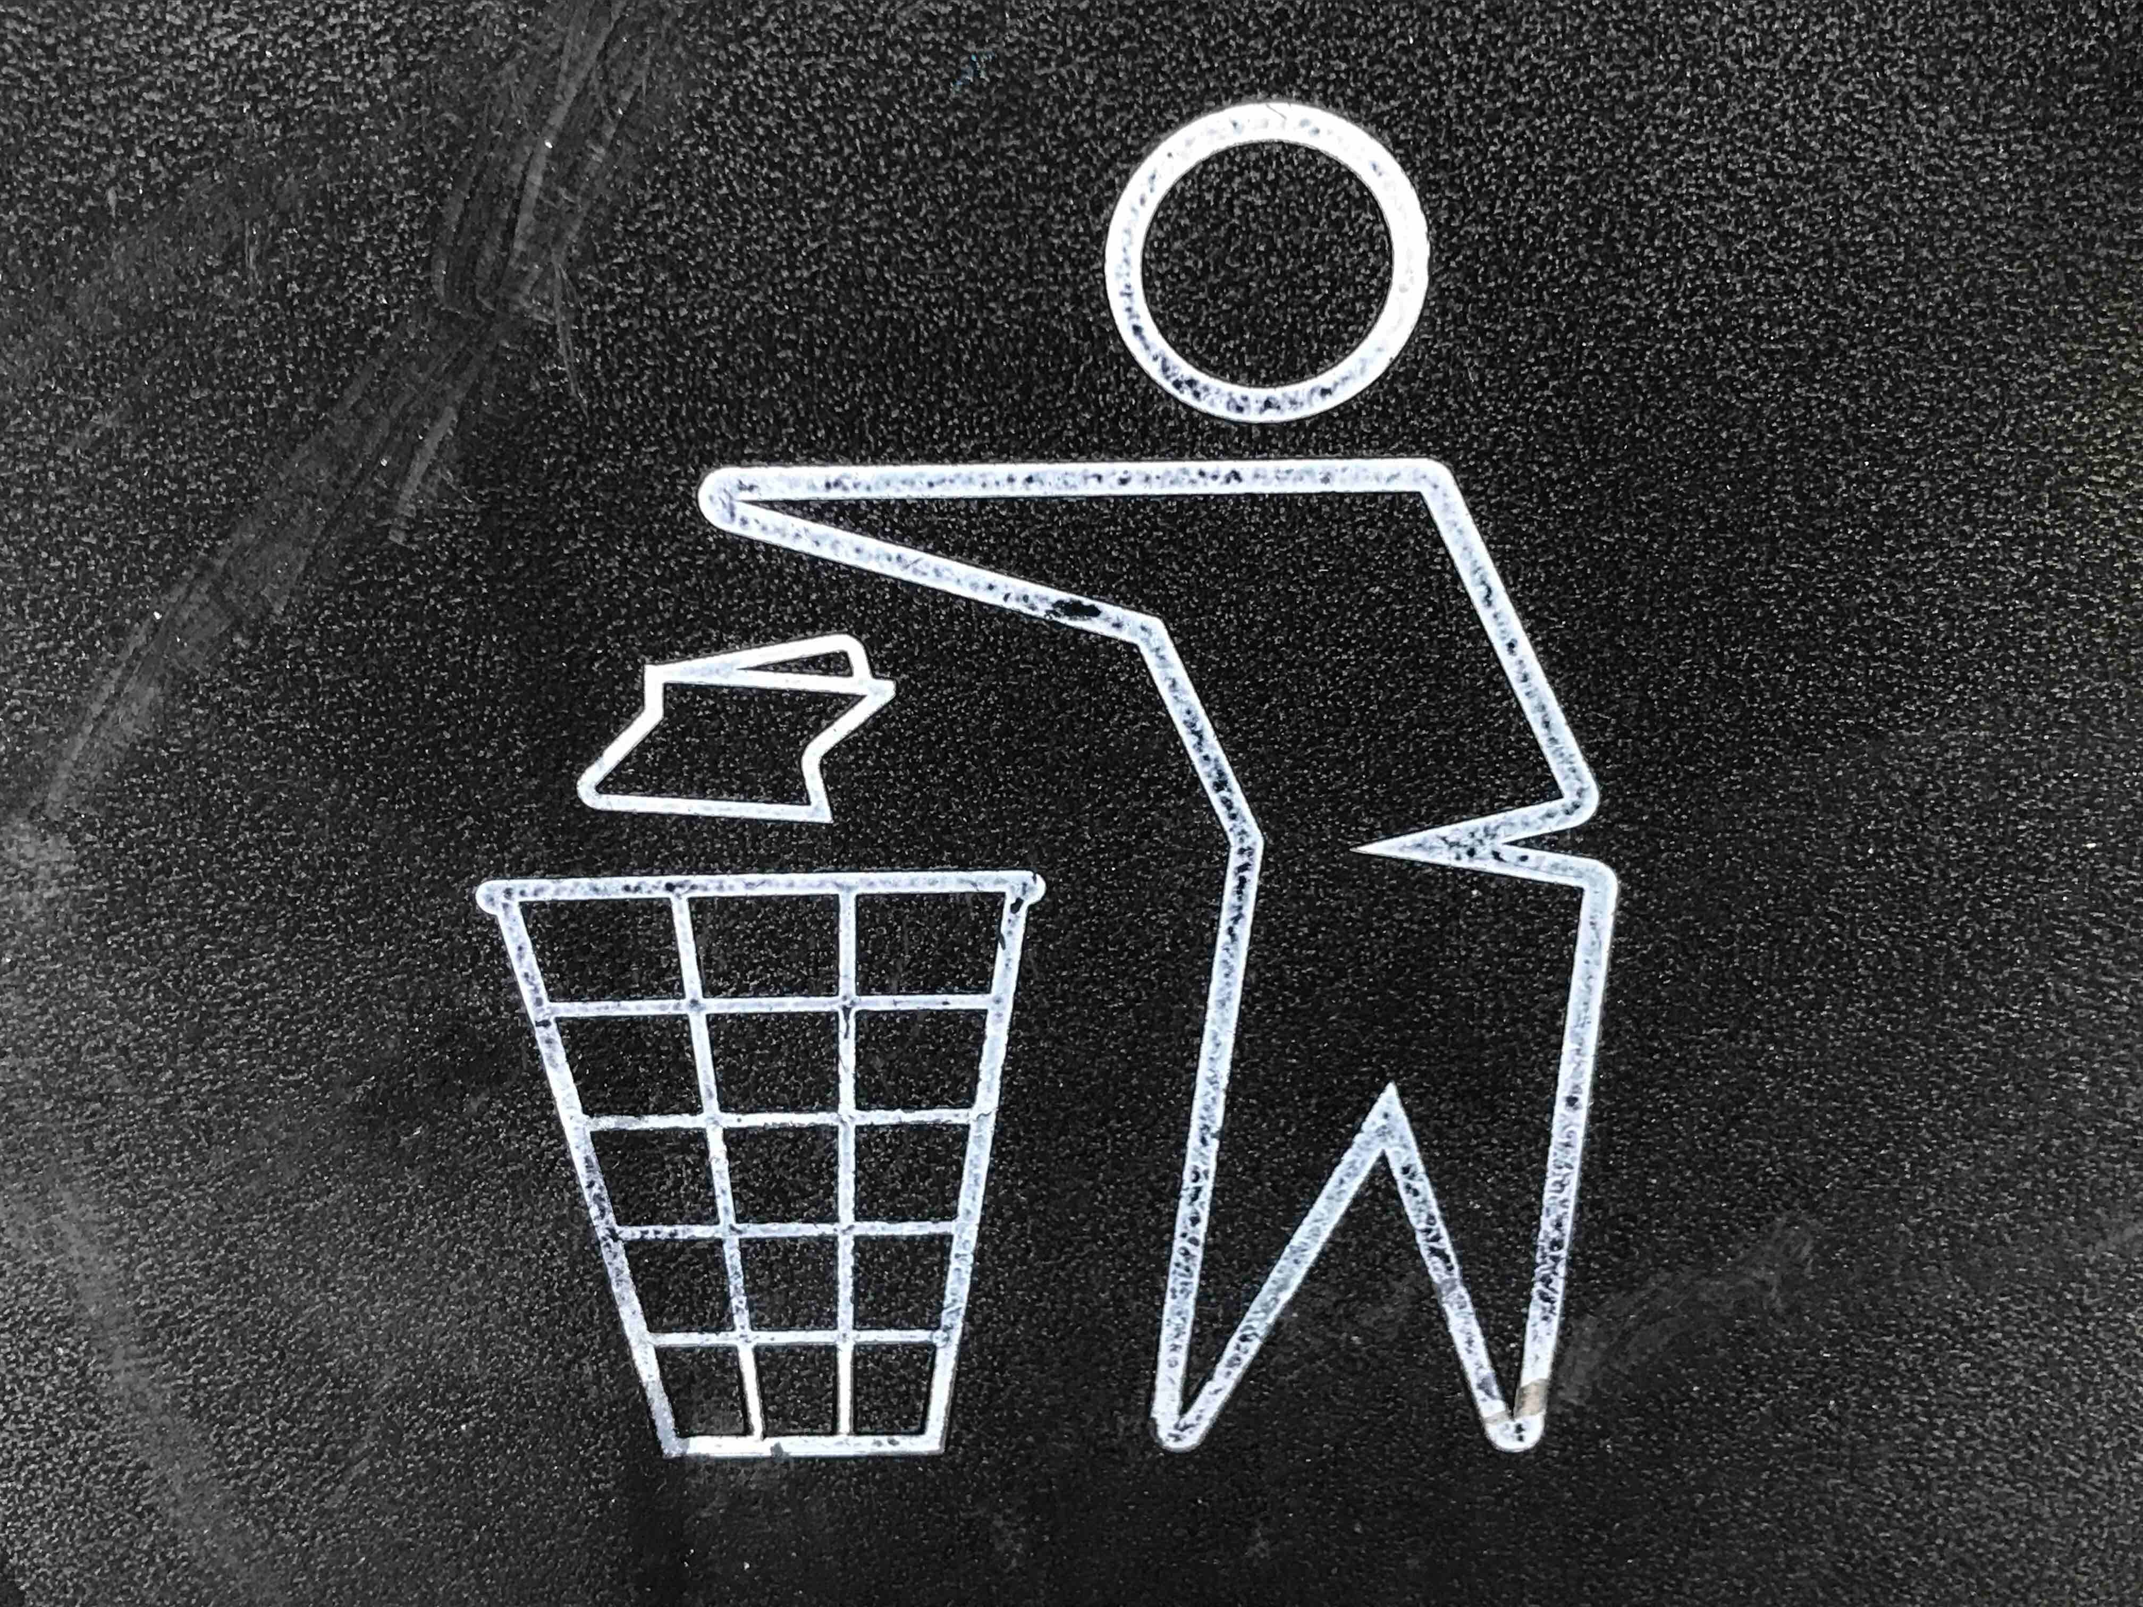
Your project
Design and make a box for a pizza of your choice
The box needs to:
be strong
have clear information on it
be easy to recycle.

Slide 8
Pizza packaging
Notes:
Show the video clip Amazing Pizza Processing and Packaging factory (4.30-6.20mins) where pizzas are packaged.

Slide 9
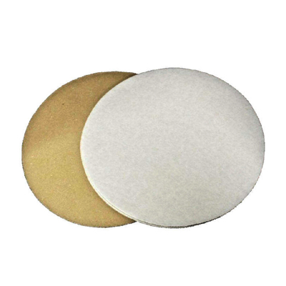
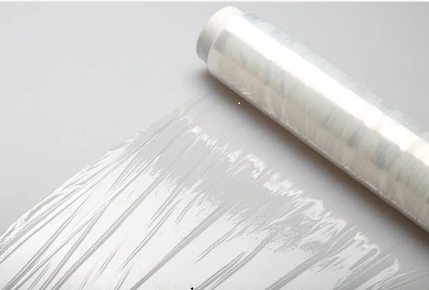
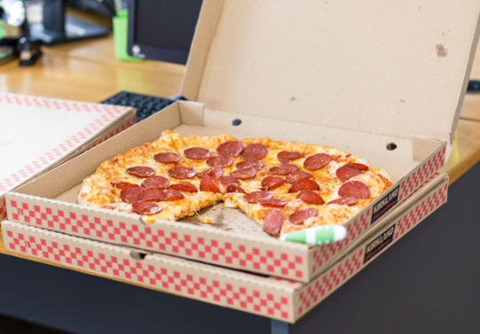
Pizza packaging
In the video, we saw that pizzas were packaged in three ways.
What were they?
Notes:
Discuss the three steps and what each packaging might be useful for. Overall message here is to protect the pizza from getting damaged.

Slide 10
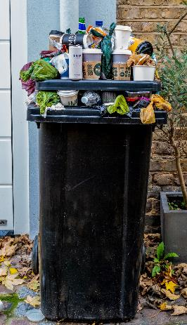
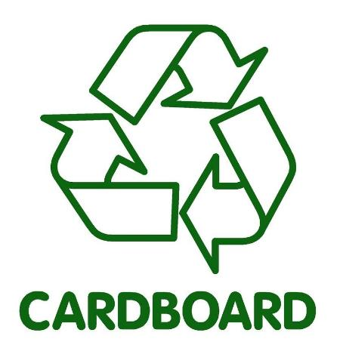
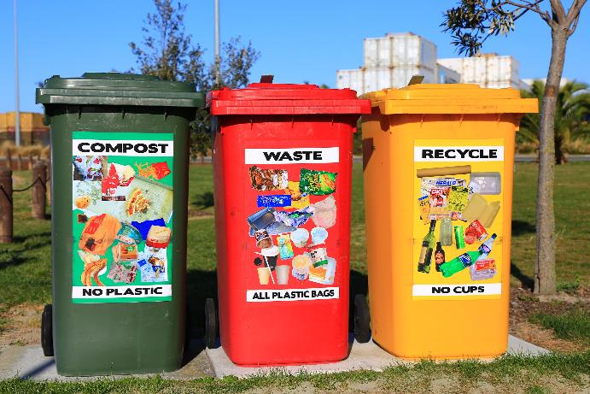
What happens to the pizza box?
Do you throw it in a waste bin or recycling bin?
Notes:
Discuss what are the options for food packaging. Can the packaging be recycled? Encourage the students to look for recycling symbols.
Do the students put waste in recycling bins or with mixed waste (where it ends up in landfill).

Slide 11
Packaging waste
A lot of food packaging ends up in waste bins.
This waste goes to landfill sites.
Landfill sites cause a lot of pollution which is bad for the environment.

Slide 12
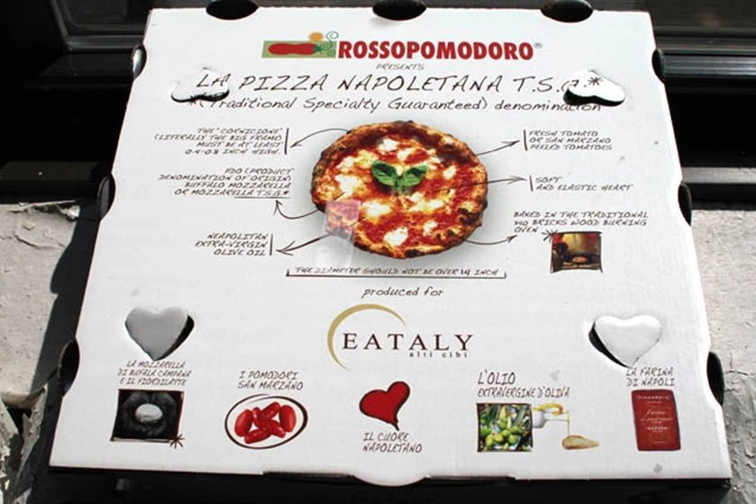
Pizza packaging
Look at a pizza box.
Find the pizza’s:
name
weight
ingredients list
cooking instructions
recycle sign.
Notes:
Discuss what other information they might find on the box including Best before date, etc.

Slide 13
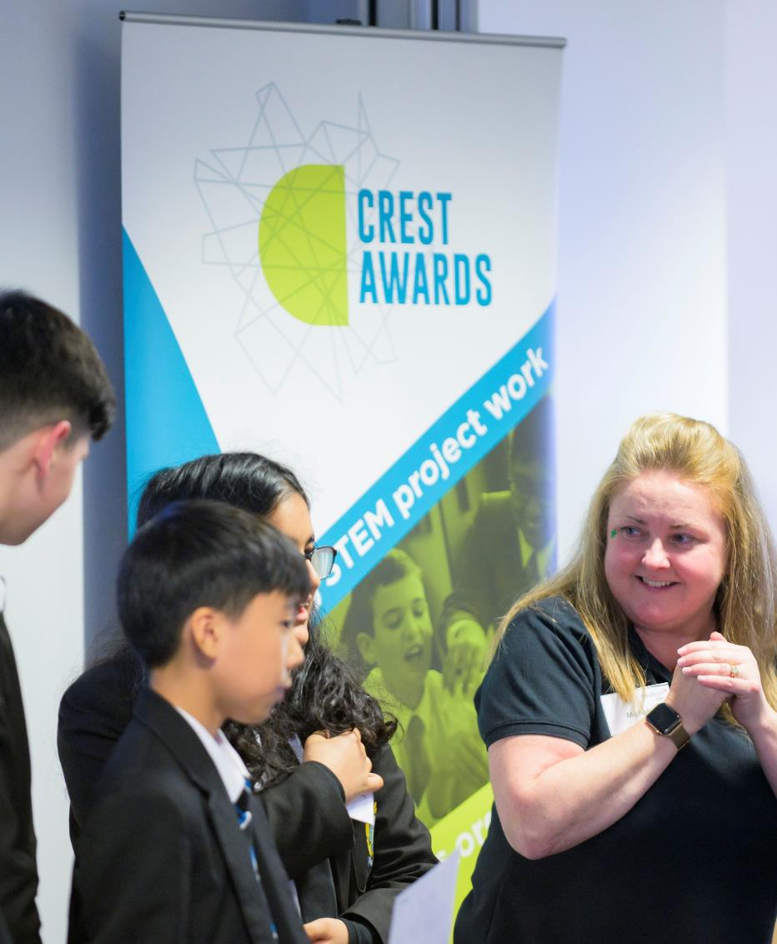
Present your project
Write a list of things to help you to talk about your project.
Do not forget to include:
the name of your pizza
how you made your box
what you are most proud of.

Slide 14
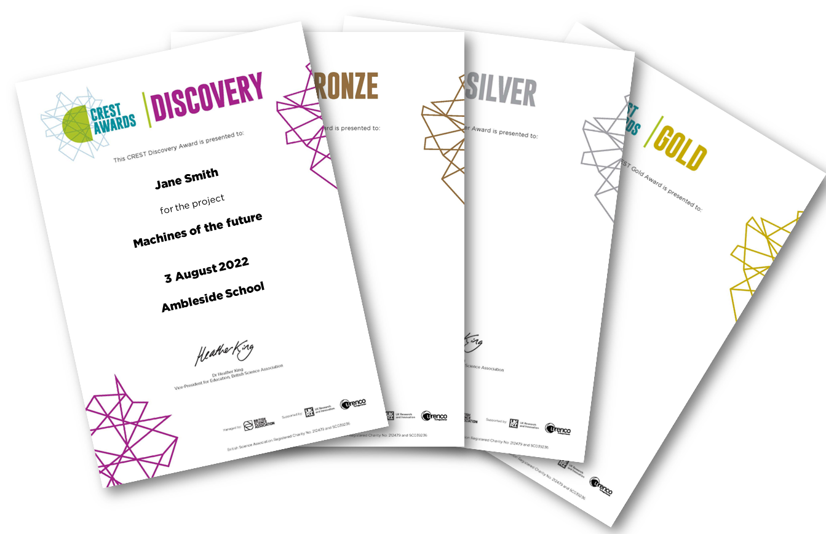
Well done!
Thank you for doing your pizza box project.
We look forward to sending you your Bronze CREST Award certificate.

Slide 15
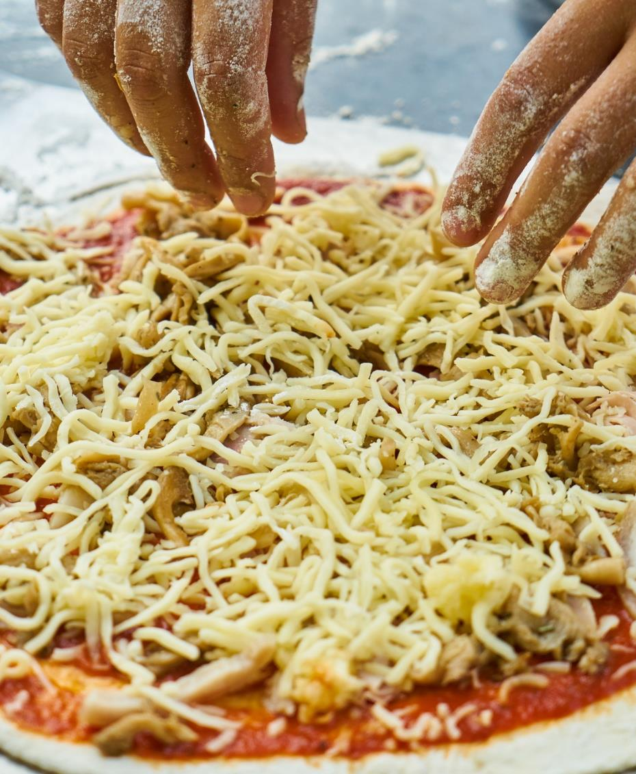
Optional extension activity: Make your own pizza
Notes:
Which toppings will you add to your own pizza?

Slide 16
Thank you

