Slide 1
Earth and beyond

Slide 2
Meet Aunt Stella, Uncle Astro, Gem and Cosmic
1

Slide 3
Activity 1
School Spotters
Cosmic and Gem want to show Uncle Astro where their school is.
Can you show Cosmic and Gem where your school is?
2

Slide 4
School Spotters
3

Slide 5
School Spotters
4

Slide 6
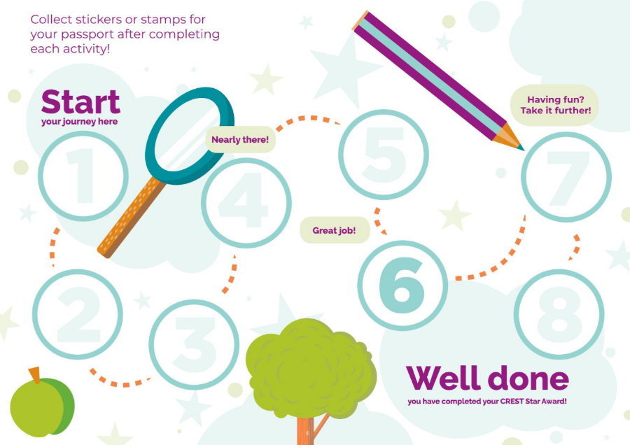
School Spotters
5

Slide 7
Activity 2
Rocket Reach
Uncle Astro and Aunt Stella are on holiday on the Moon. Cosmic and Gem want to go and see them.
Can you make a rocket to get them there?
6

Slide 8
Rocket Reach
7

Slide 9
Rocket Reach
8

Slide 10
Rocket Reach
9

Slide 11
Activity 3
Lunar Landers
Cosmic and Gem managed to make a rocket that could help them to reach the Moon. Now they can see Uncle Astro and find out some information about the Moon.
The only problem now is they must land safely. Can you help them?
10

Slide 12
Lunar Landers
11

Slide 13
Lunar Landers
12

Slide 14
Lunar Landers
13

Slide 15
Activity 4
Crater Creators
Cosmic and Gem can see some of the craters on the surface of the Moon.
They want to find out how they can make the biggest crater. Can you help them?
14

Slide 16
Crater Creators
15

Slide 17
Crater Creators
16

Slide 18
Activity 5
Galactic Gardeners
Cosmic and Gem wave goodbye to Uncle Astro. They leave the Moon and return to planet Earth.
Can you help Cosmic and Gem to find out how to grow food and whether it is possible for Uncle Astro to grow food on the Moon?
17

Slide 19
Galactic Gardeners
18

Slide 20
Galactic Gardeners
19

Slide 21
Galactic Gardeners
20

Slide 22
Activity 6
Constellation Counters
Cosmic and Gem are looking out of the window and want to know more about what they can see.
Can you help them to identify what they can see in the night sky?
21

Slide 23
Constellation Counters
22

Slide 24
Constellation Counters
23

Slide 25
Constellation Counters
24

Slide 26
Constellation Counters
25

Slide 27
Constellation Counters
26

Slide 28
Activity 7
Mask Makers
It’s the summertime and Cosmic wants to stay up late so that he can view the constellations in the night sky. He needs to have an afternoon nap, but the Sun is so bright that he can’t sleep.
Can you help him to make a mask so he is able to sleep?
27

Slide 29
Mask Makers
28

Slide 30
Activity 8
Astronaut Antics
Gem and Cosmic have decided that after going to the Moon and learning more about the night sky, they now want to become astronauts. To do this they need to do some training.
Can you take part in some training with them?
29

Slide 31
Astronaut Antics
30

Slide 32
Astronaut Antics
31

