Slide 1
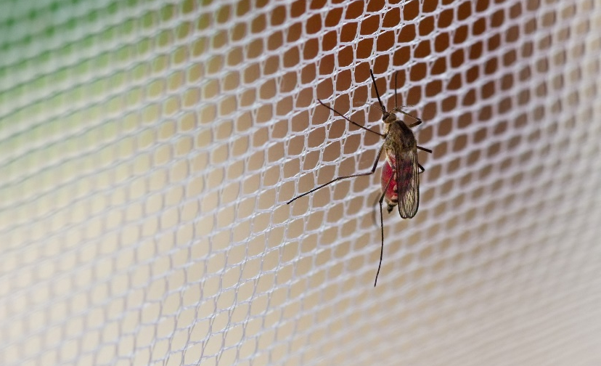
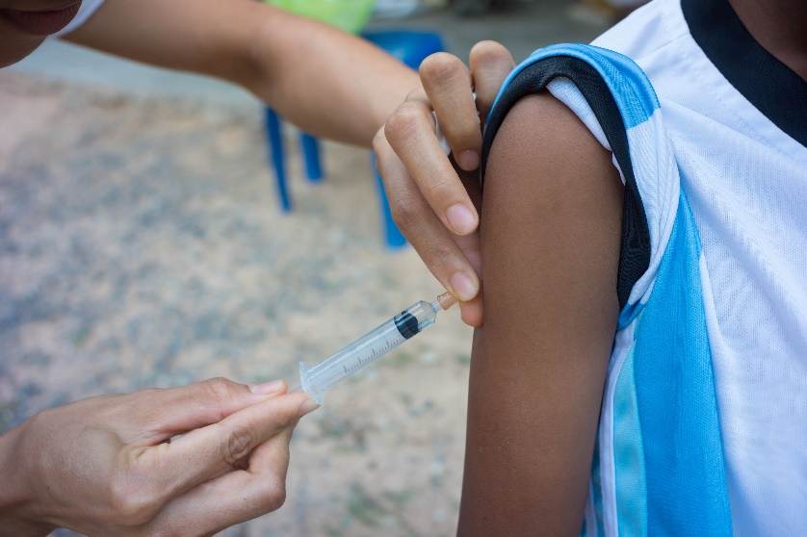
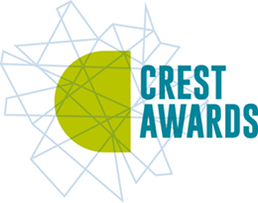

STOP THE SPREAD
A STEM challenge tackling a global problem…
the spread of infectious diseases
Notes:
To change the colour of the slide click Format/Slide design and choose from the options in the task pane on the right
A selection of pictures that will fit into this space are available here

Slide 2


No one wants to get ill
Think about the last time you were ill.
Was it a cough or a cold ? Something worse like measles? What is the worst illness you have had?
There are lots of different diseases. Some happen everywhere whilst others, like malaria, occur more in developing countries where people do not have access to clean water and good hygiene and sanitation.

Slide 3

How do we get diseases?
Infectious diseases are diseases caused by micro-organisms that penetrate the body’s natural barriers.
In two minutes brainstorm all the different diseases you know, here and around the world and divide them into infectious diseases and non-infectious diseases.
Infectious Diseases
Non-infectious Diseases

Slide 4

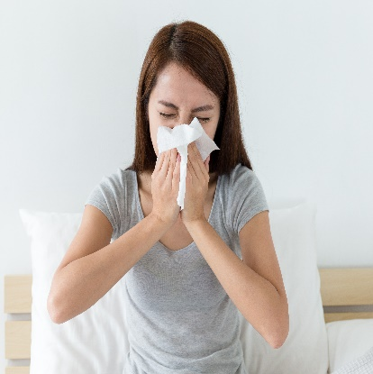
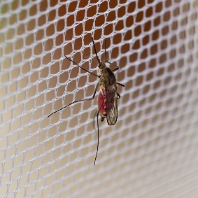
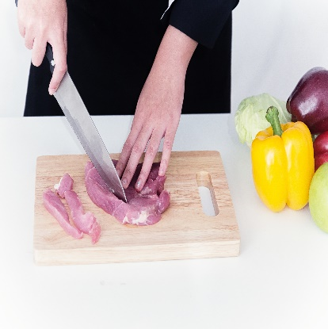

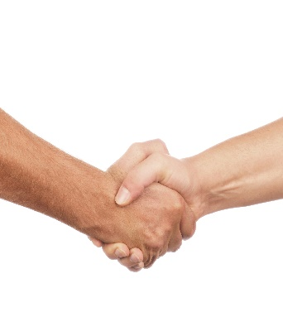

How do infectious diseases spread?
Any ideas?...
Brainstorm in two minutes!

Slide 5
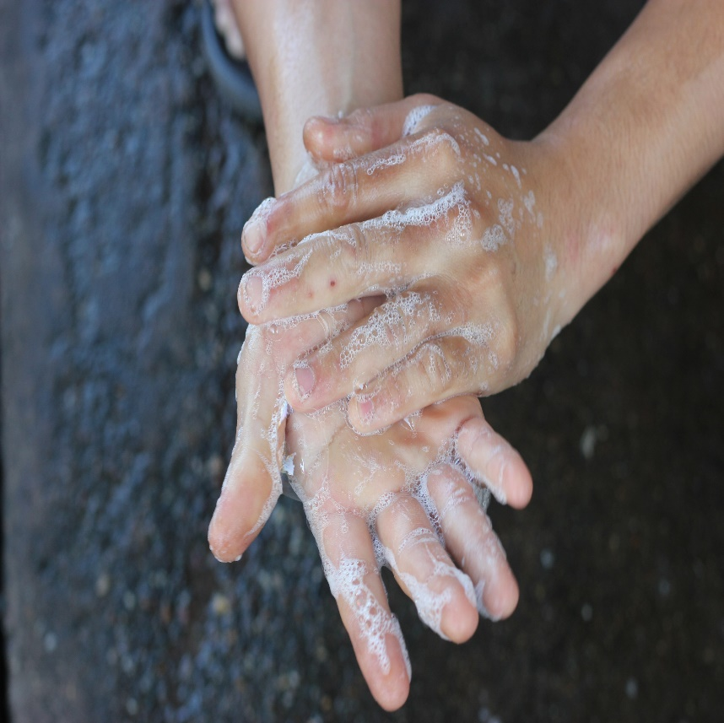
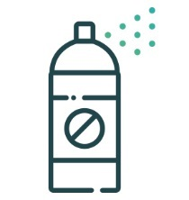
Let’s shake hands?
Your Stop the Spread challenge will focus on preventing diseases that are spread by hand to hand contact.
To help get you thinking about this topic you are going to do two short activities to discover more about…
How quickly infectious diseases can spread.
What you can do to reduce the spread of infection.

Slide 6

Infectious disease – a global problem
Has anyone heard of the Global Goals or Sustainable Development Goals?
In 2015 The UN put together a set of 17 Sustainable Development Goals (SDGs) or Global Goals to end poverty by 2030.
Two focus on the prevention of infectious diseases… so it is a really important issue!
Global Goal 3: Good health and well-being.
Global Goal 6: Water and Sanitation.

Slide 7
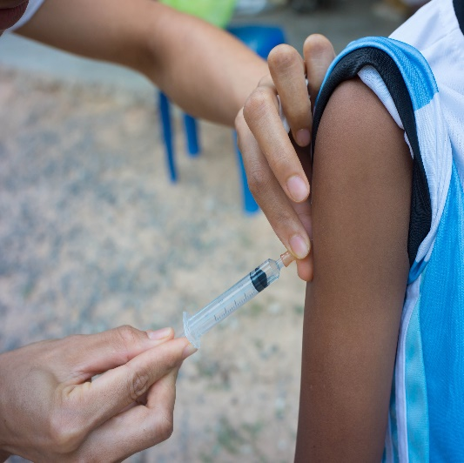
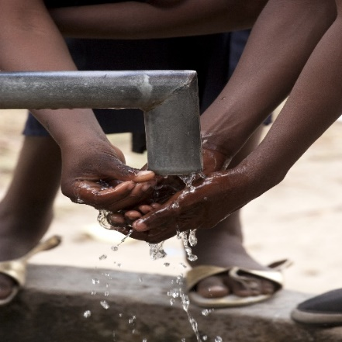
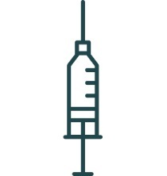
What is already being done?
Educating children
https://vimeo.com/169209845
Child-to-child training
Read the case study from Kenya.
Briefly discuss some of the things that can be done to reduce the spread of disease in communities such as those in Kenya.

Slide 8
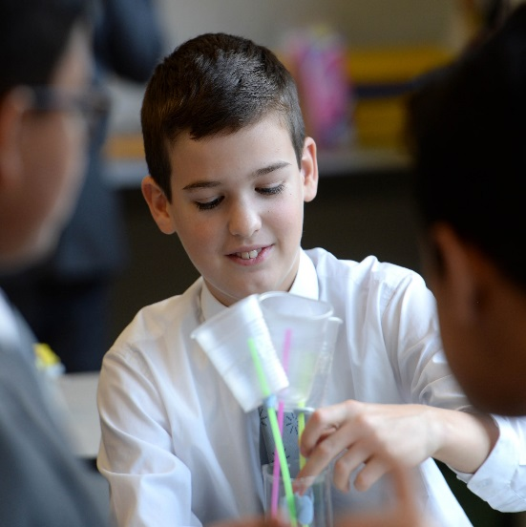

Your 'Stop the spread' challenge
Imagine you work for a charity and have received some funding to help pupils in a school in Kenya reduce the spread of disease in their school.
Your challenge is to:
Build a model of a hand washing device that could go in their playground which will enable them to capture rainwater then use it to wash their hands.
Develop education materials which will help children aged 8-11 understand why hand washing is important. This could be a poster, animation, game, play, leaflet.

Slide 9
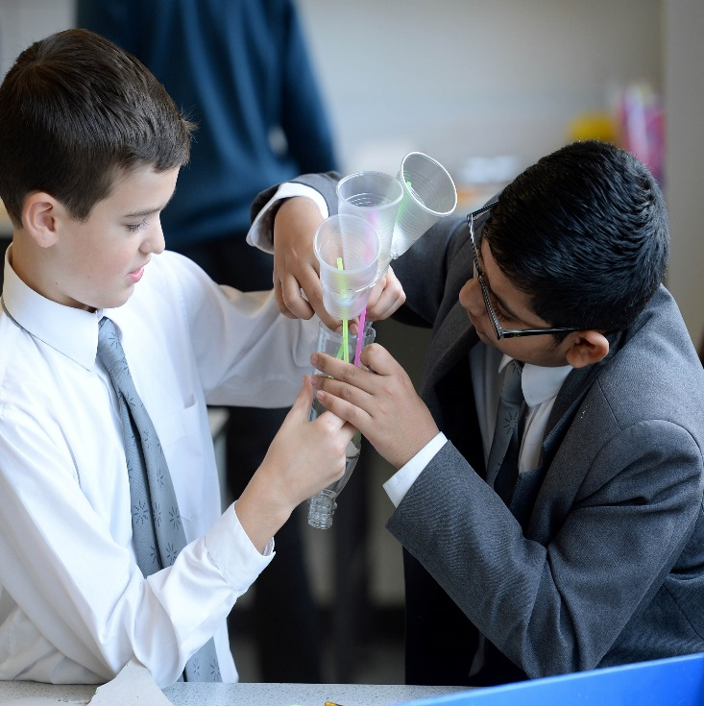
How will you be judged?
You will be judged on the following:
Teamwork – Did you have different roles and work collaboratively?
Research – How did you use your research to help you in your tasks?
Designing – Did you do good, annotated initial and final designs?
Model – How creative was your model? Did you use sustainable material where possible? Did you stick to the budget? How well did it do in the test?
Education Materials – What and how did you communicate to the pupils? Are your materials engaging for 8-11 year olds?

Slide 10
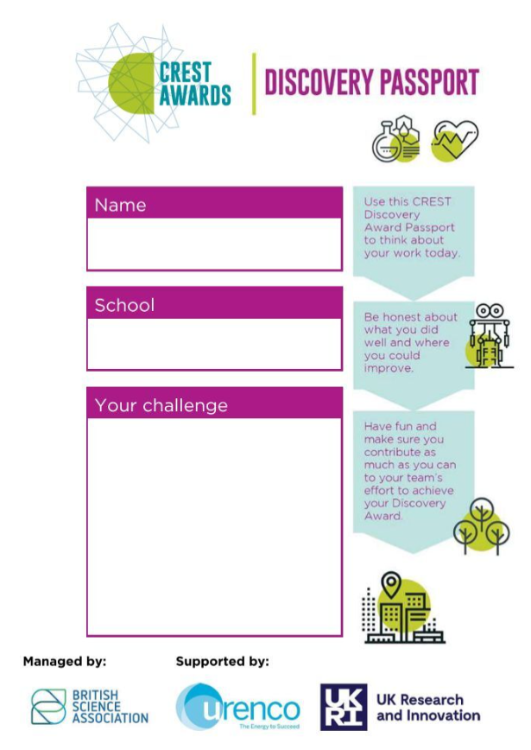
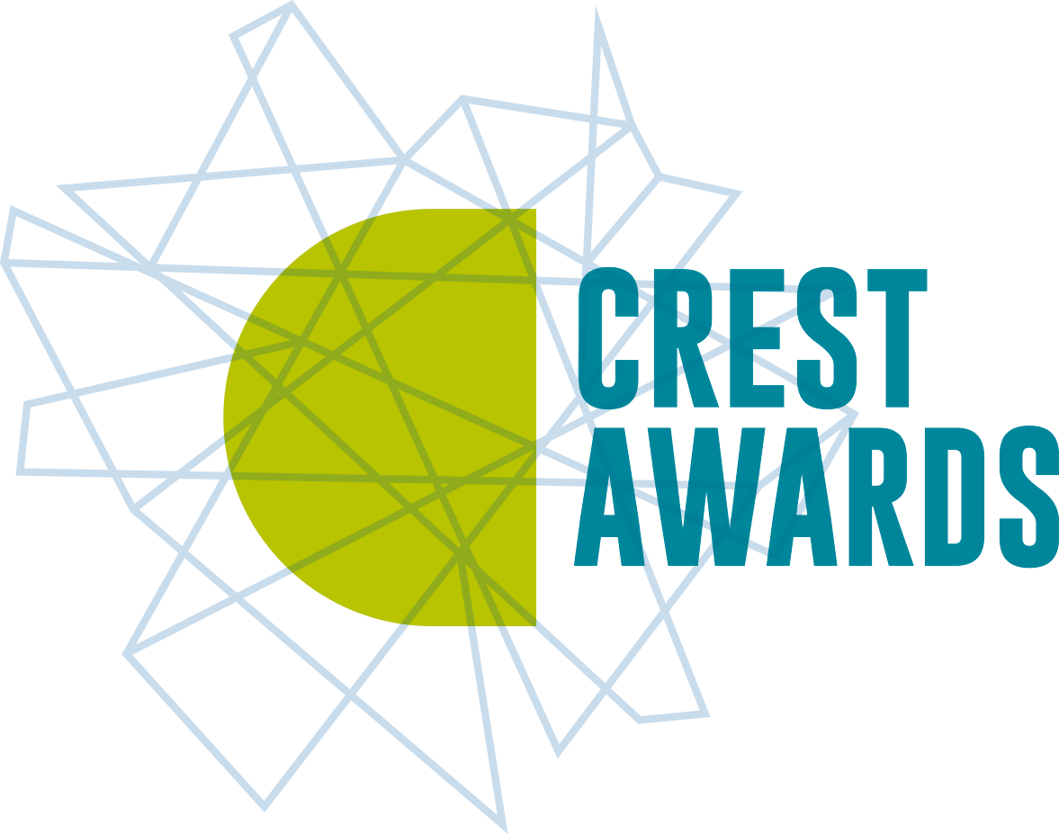
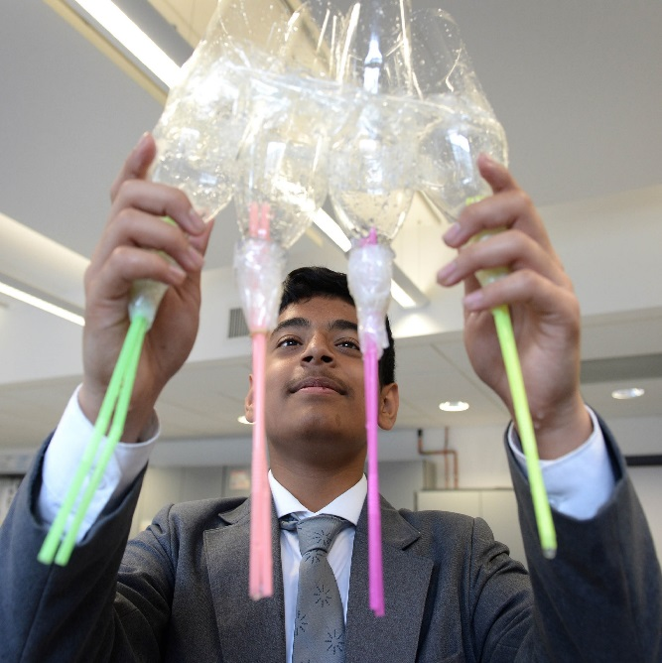
CREST Discovery Award
Fill out your CREST Discovery Passport throughout the day to document your learning and earn your CREST Award!

Slide 11
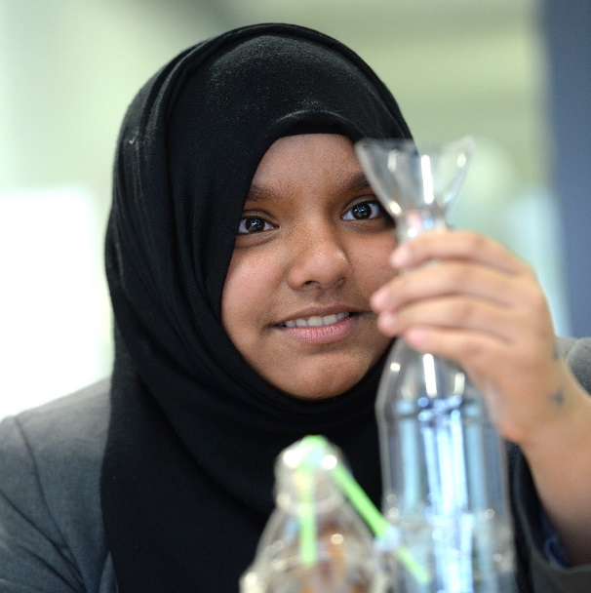

Key things to remember
For your hand washing device
Remember it must be able to both collect and dispense water.
It must use water efficiently (water is scarce in Kenya).
Think about how to avoid cross-contamination.
You have a budget – 125 credits, use it wisely!
Use locally available, sustainable materials when possible.

Slide 12
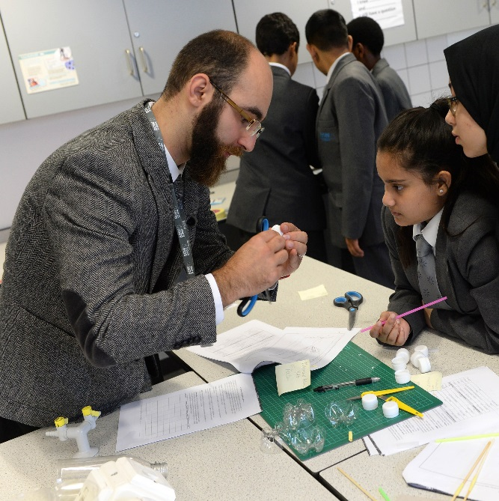
Key things to remember
For your education materials
Be creative, children are more likely to remember something presented in an interesting, fun way.
Do your research to get key facts and figures.
8-11 year olds in Kenya may have low levels of literacy.
Make sure your main messages stand out.
Consider using more than one way of getting your message across. Game, poster, song, play etc.

Slide 13


What do they do in Kenya?
Engineers in Kenya have come up with a simple design for a hand washing station which is widely used and looks like this…
It’s called a ‘Tippy Tap’. It only dispenses water, it doesn’t collect it.
How does your model compare to this? Do you think your model is better?

