Slide 1
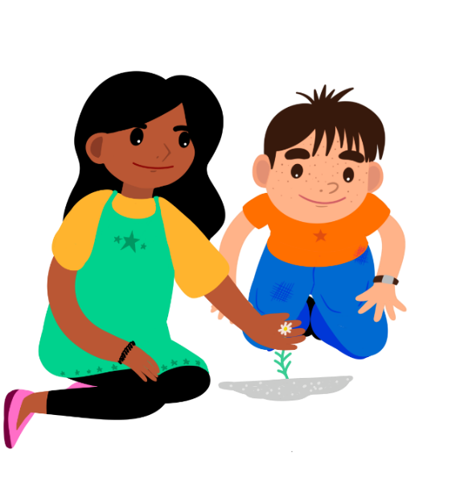
Plant Detectives
Supported by:

Slide 2
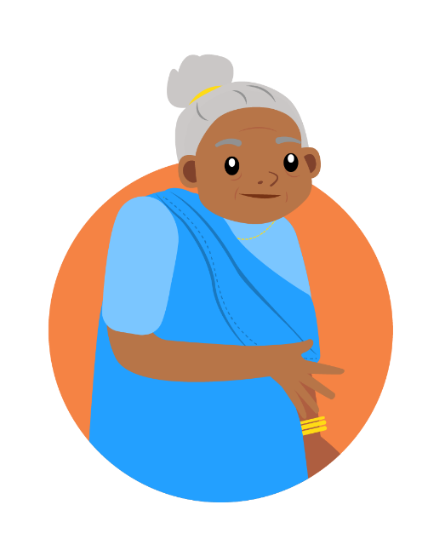
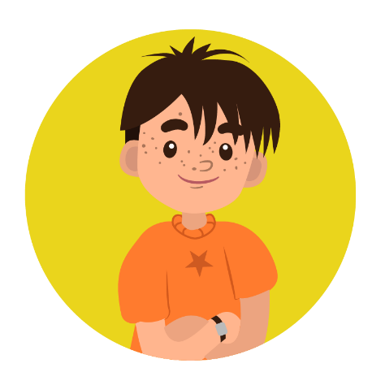
Meet the characters...
Tara
Zeke
Joyti
Grandmother to Tara

Slide 3
Zeke has spotted something outside Tara's house.
How did that plant get there? Plants usually grow in gardens, not pavements!

Slide 4
What a mystery!
I wonder whether it might have grown from a seed under the pavement. Who could have planted the seed?
Maybe someone dropped it as they walked along!

Slide 5
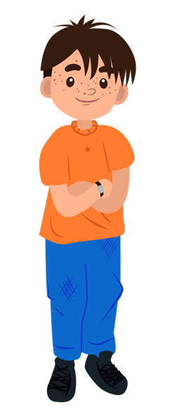
How can Tara and Zeke find out more?
We need to be plant detectives and solve this mystery!
Where have you seen plants growing?

Slide 6
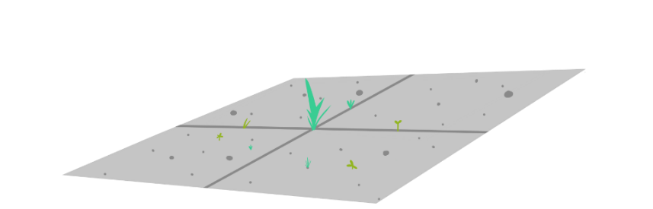
Where will we go to be plant detectives?
Where will we look for clues about plants?
How will we stay safe?

Slide 7
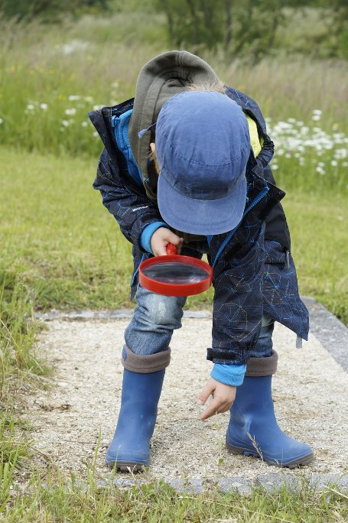
Recording your results
You could draw pictures or take photos of the plants you find.
Maybe you could mark them on a map!

Slide 8
Take it further...
Can you find out the names of the plants you discover?
Do all plants need soil to grow?

Slide 9
Well done!
You can add a stamp or sticker to your CREST Passport!

