Slide 1
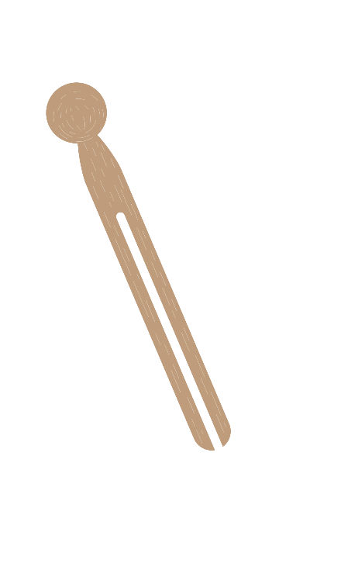
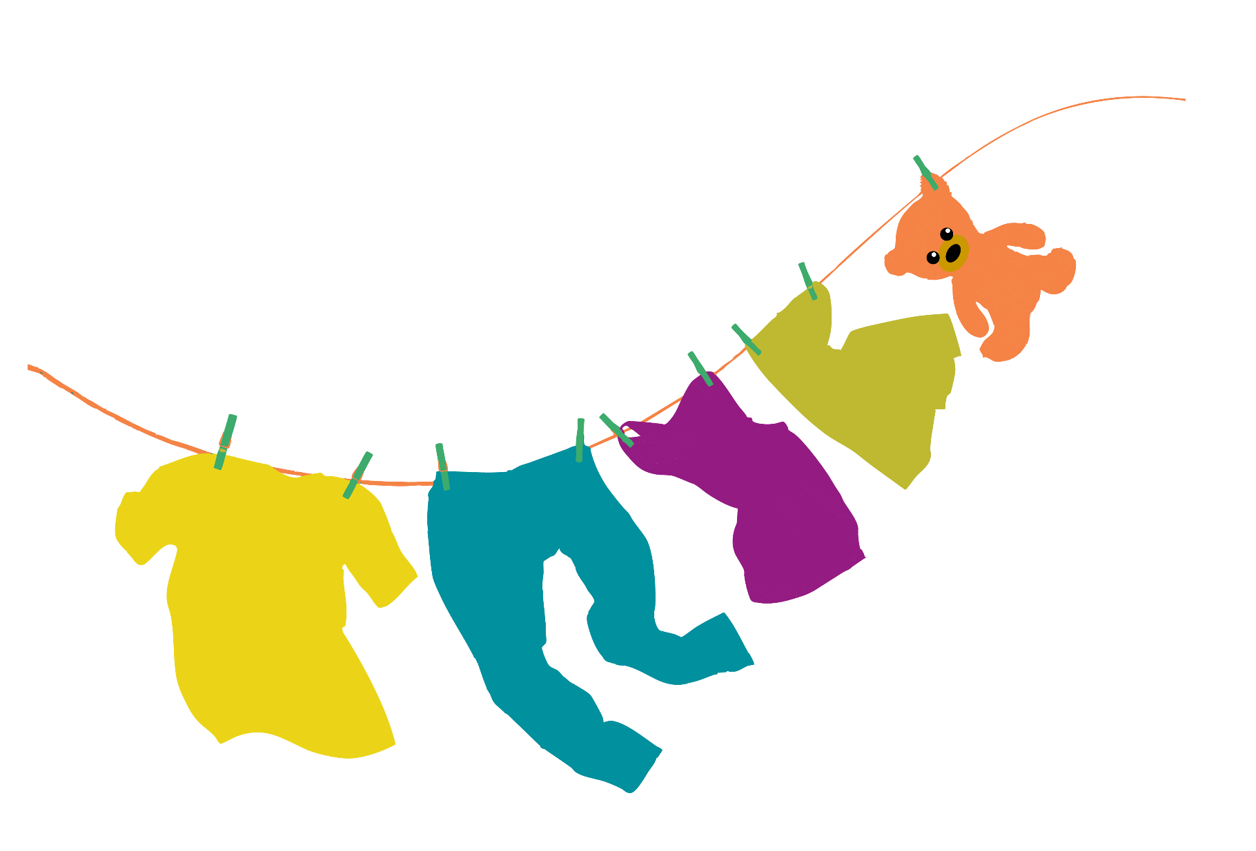
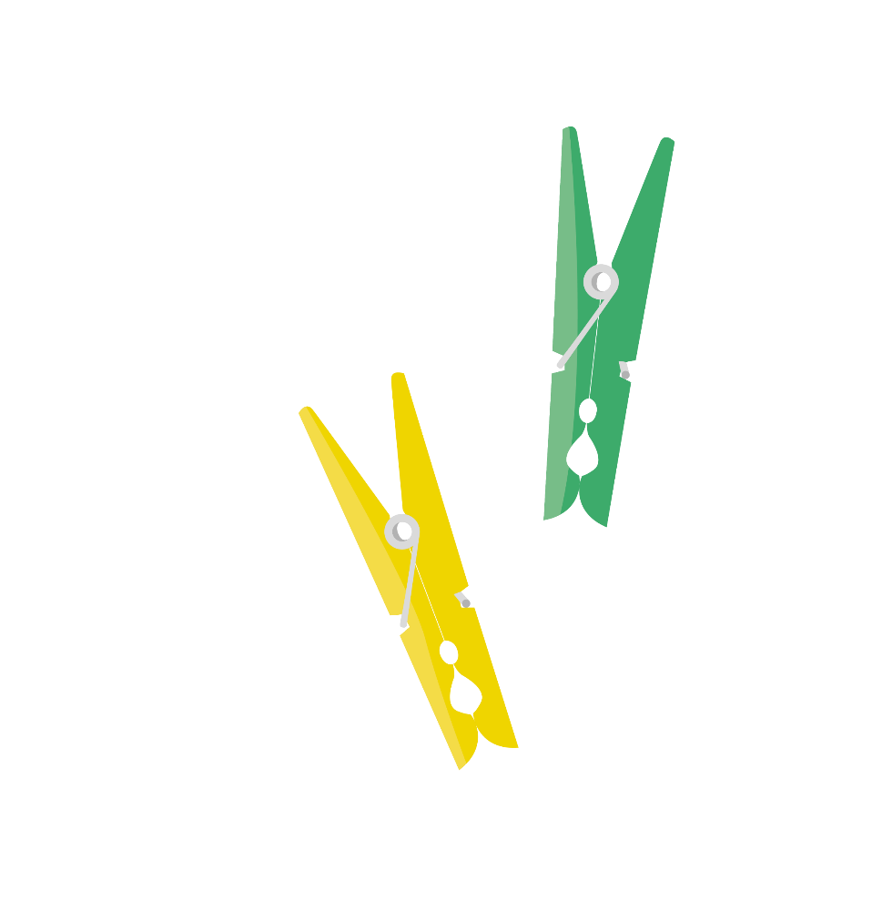
Peggy Problem
Supported by:

Slide 2
Meet the characters...
Aunt Stella
Auntie to Cosmic and Gem
Gem
Cosmic

Slide 3
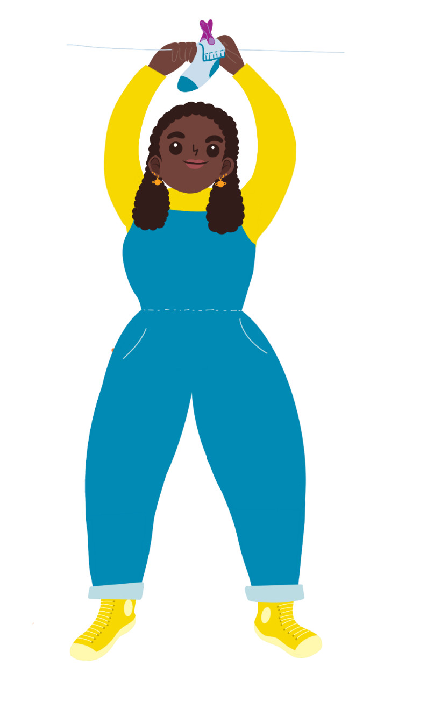
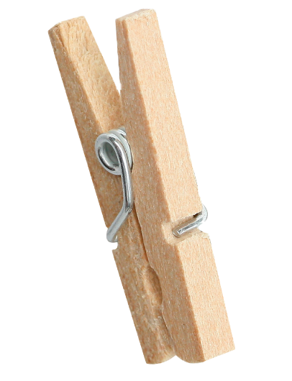
Aunt Stella is doing some washing.
Warm and windy! It’s a perfect day for washing clothes.
Can we help hang the washing out to dry?

Slide 4
Some of the clothes fall off the washing line.
Oh no! I don't think the clothes pegs are grippy enough!
We could test some different pegs to see if they would be better!

Slide 5
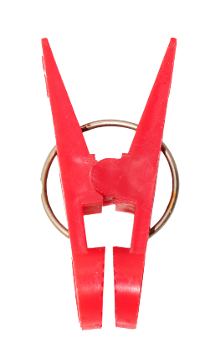
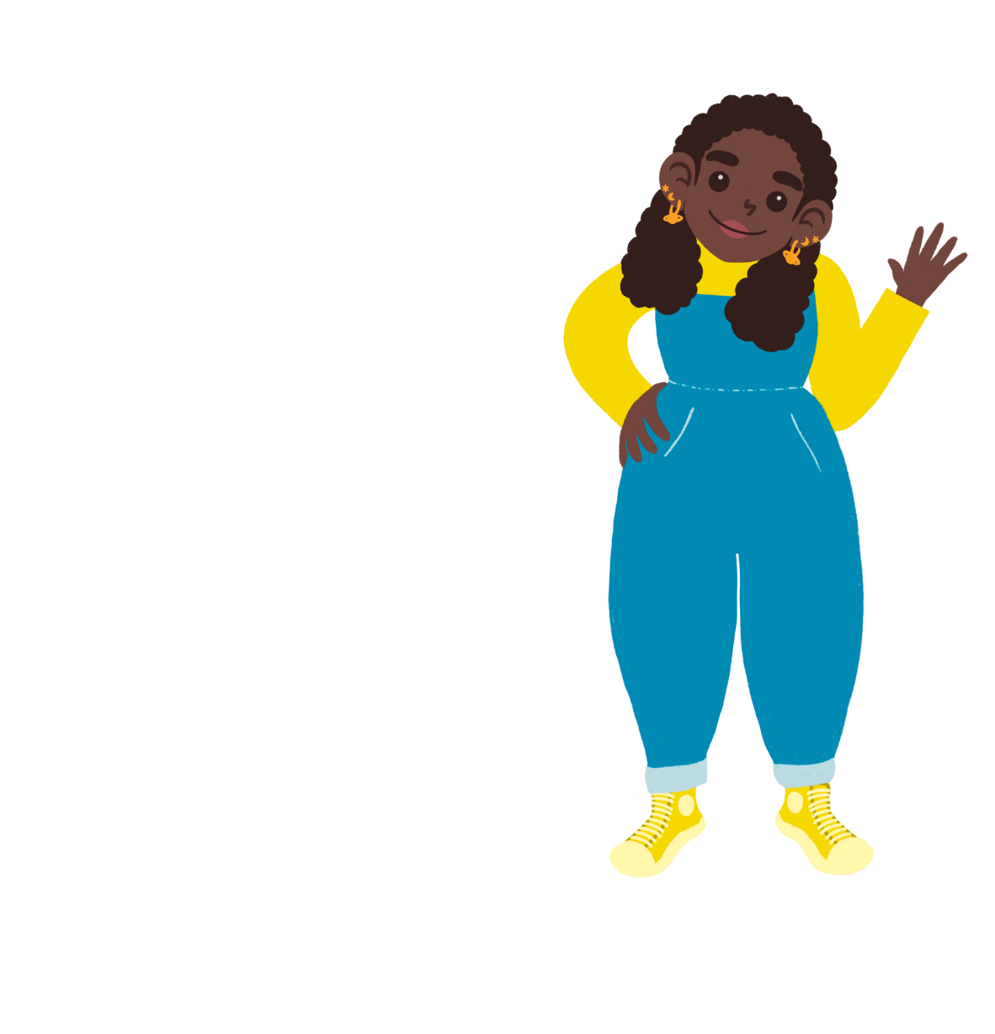
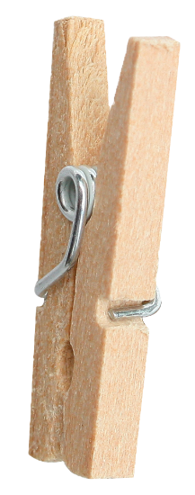
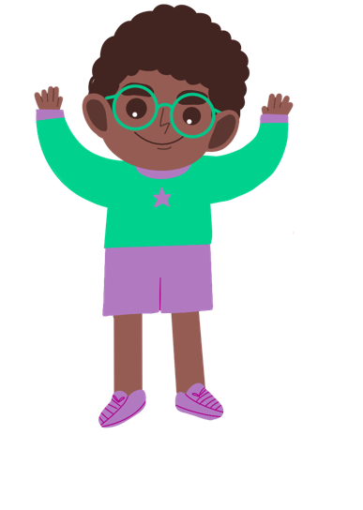
Which pegs do you think have the best grip?
I think a peg with a spring will have the most grip
I think plastic pegs will have a tight grip.
I think wooden pegs will have the best grip as wood is stronger.

Slide 6
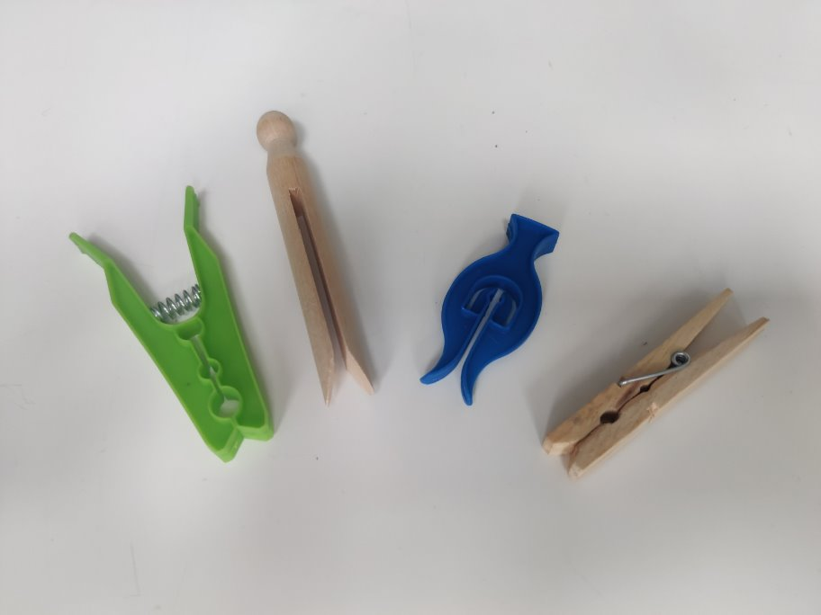
Which peg do you think will work best?
How can you find out?

Slide 7
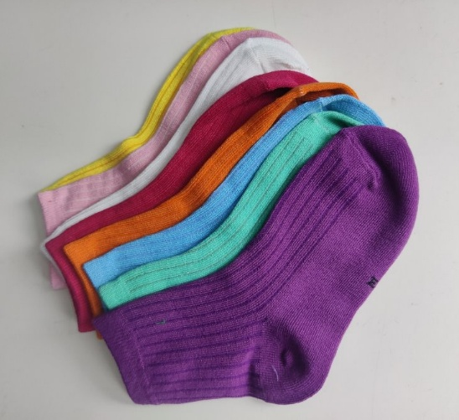
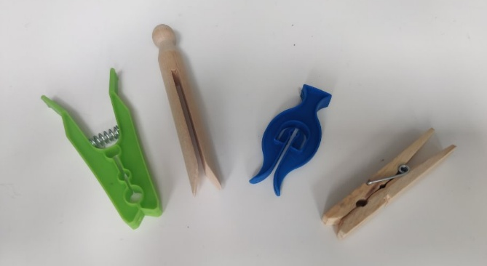
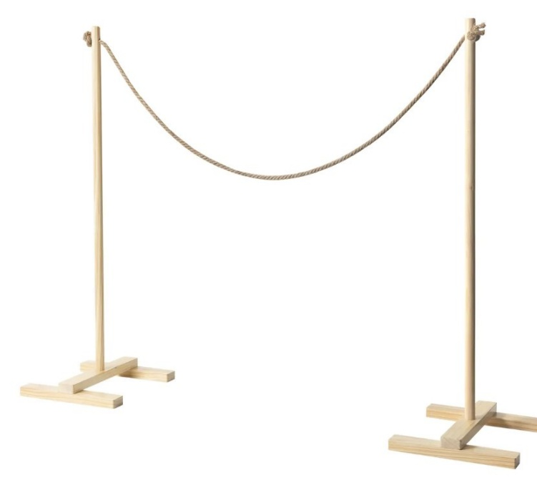
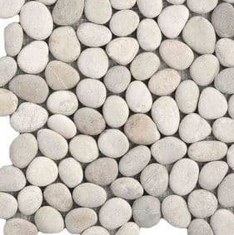
Testing
pegs
socks
pebbles, marbles or sand
washing line

Slide 8
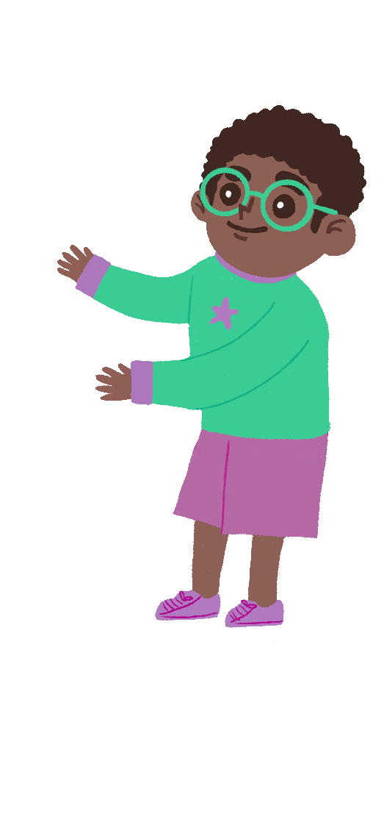
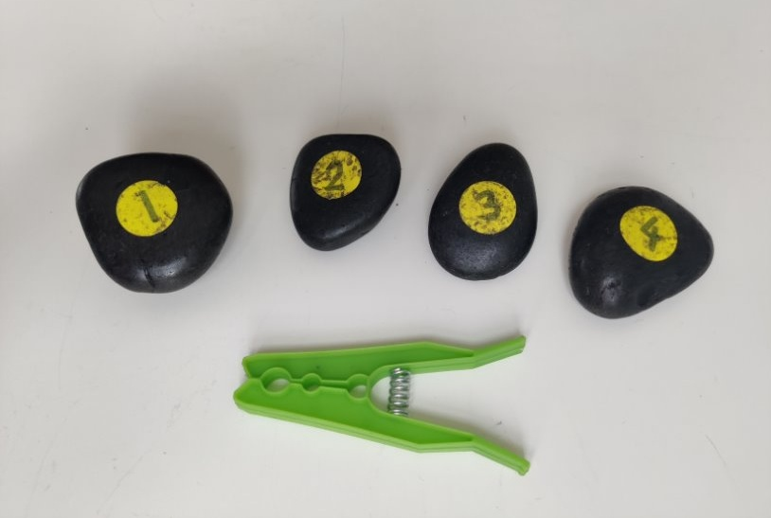
Recording your results
You could take photos or draw pictures of your results!
Which peg should I use?

Slide 9
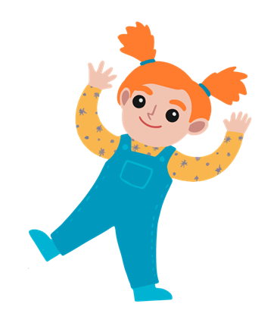
Take it further...
I wonder if some clothes dry faster than others?
Do clothes dry better on a windy day or a still day? How could we find out?

Slide 10
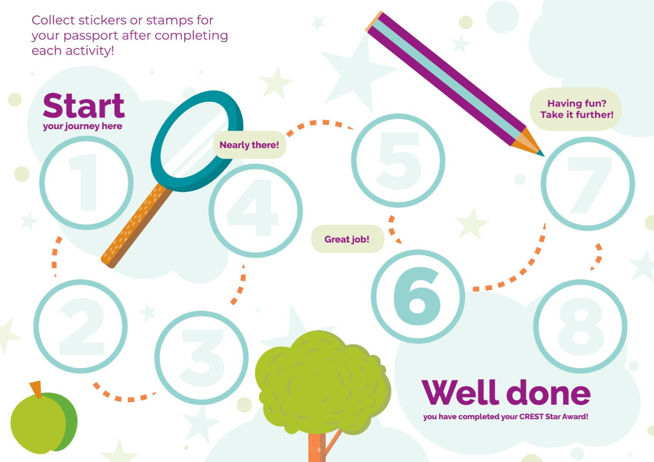
Well done!
You can add a stamp or sticker to your CREST Passport!

